Slide 1
DNMs

Slide 2
Run 1

Slide 3
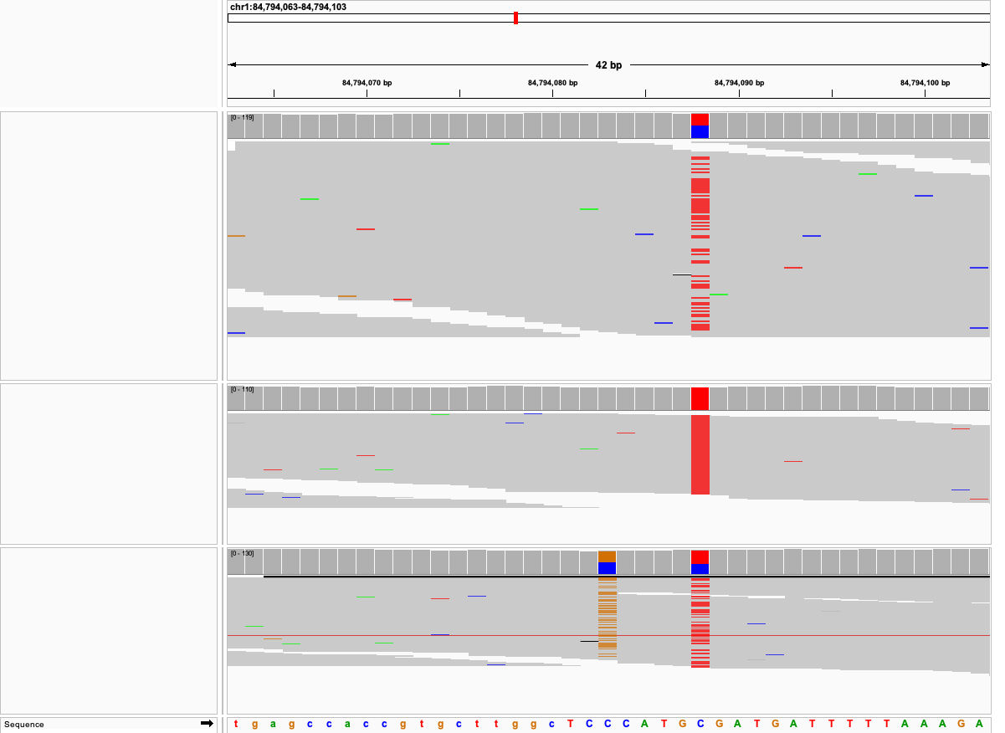
Dam
Sire
Offspring

Slide 4
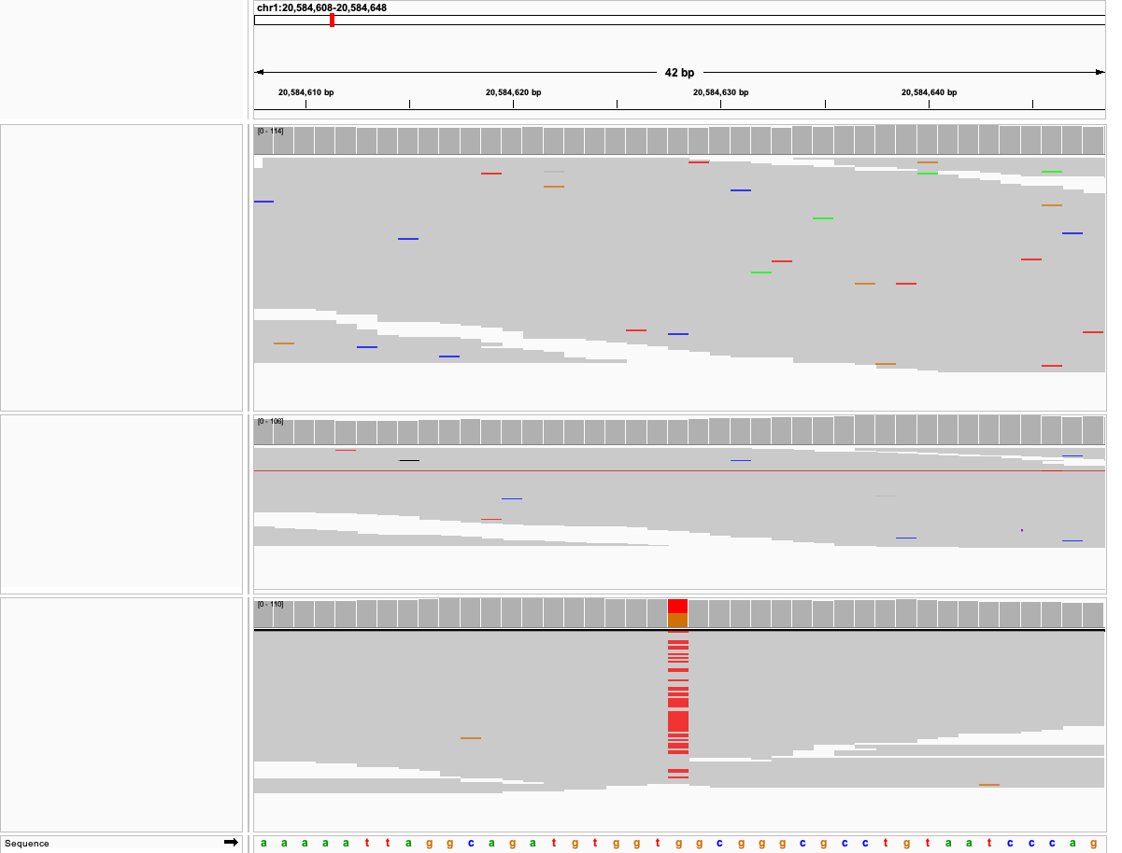
Dam
Sire
Offspring

Slide 5
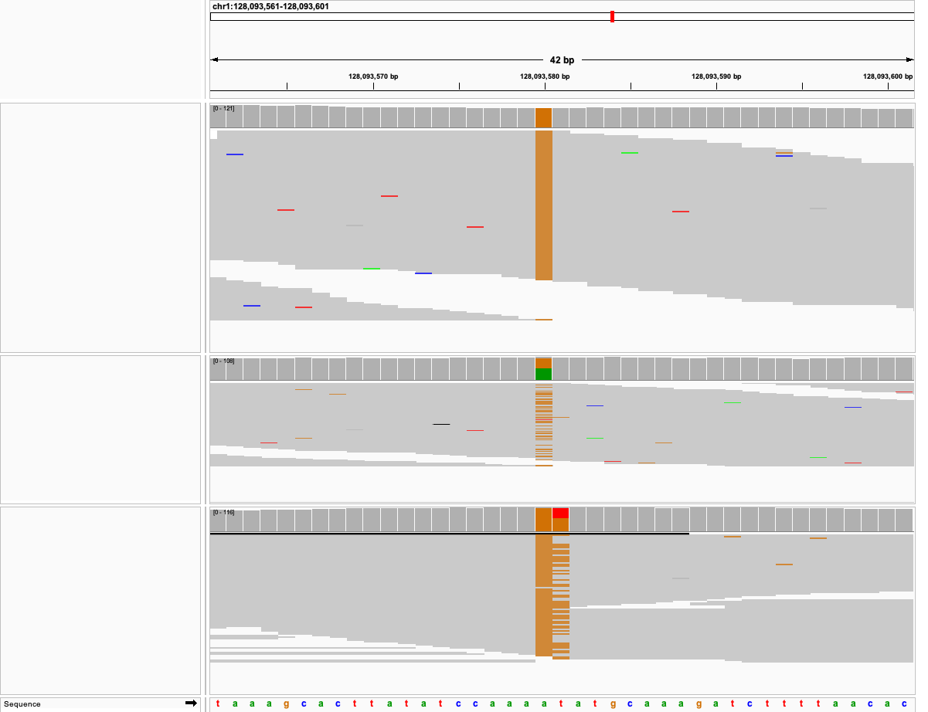
Dam
Sire
Offspring

Slide 6
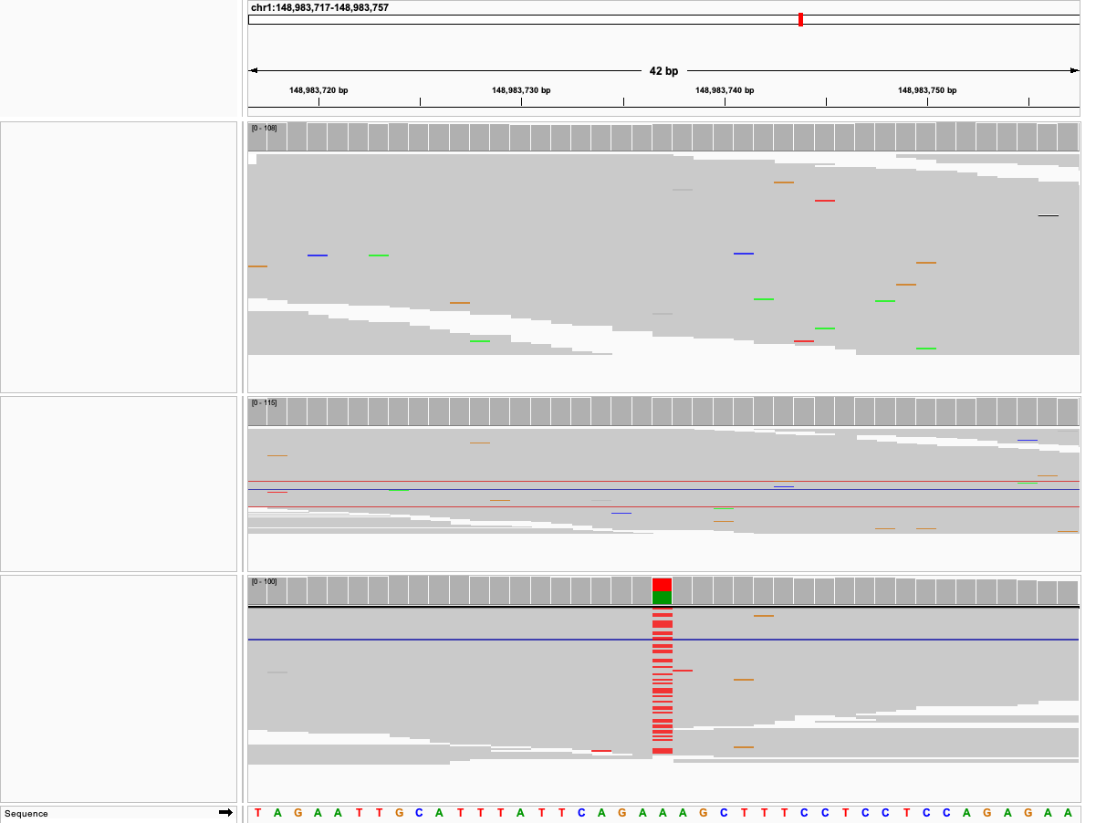
Dam
Sire
Offspring

Slide 7
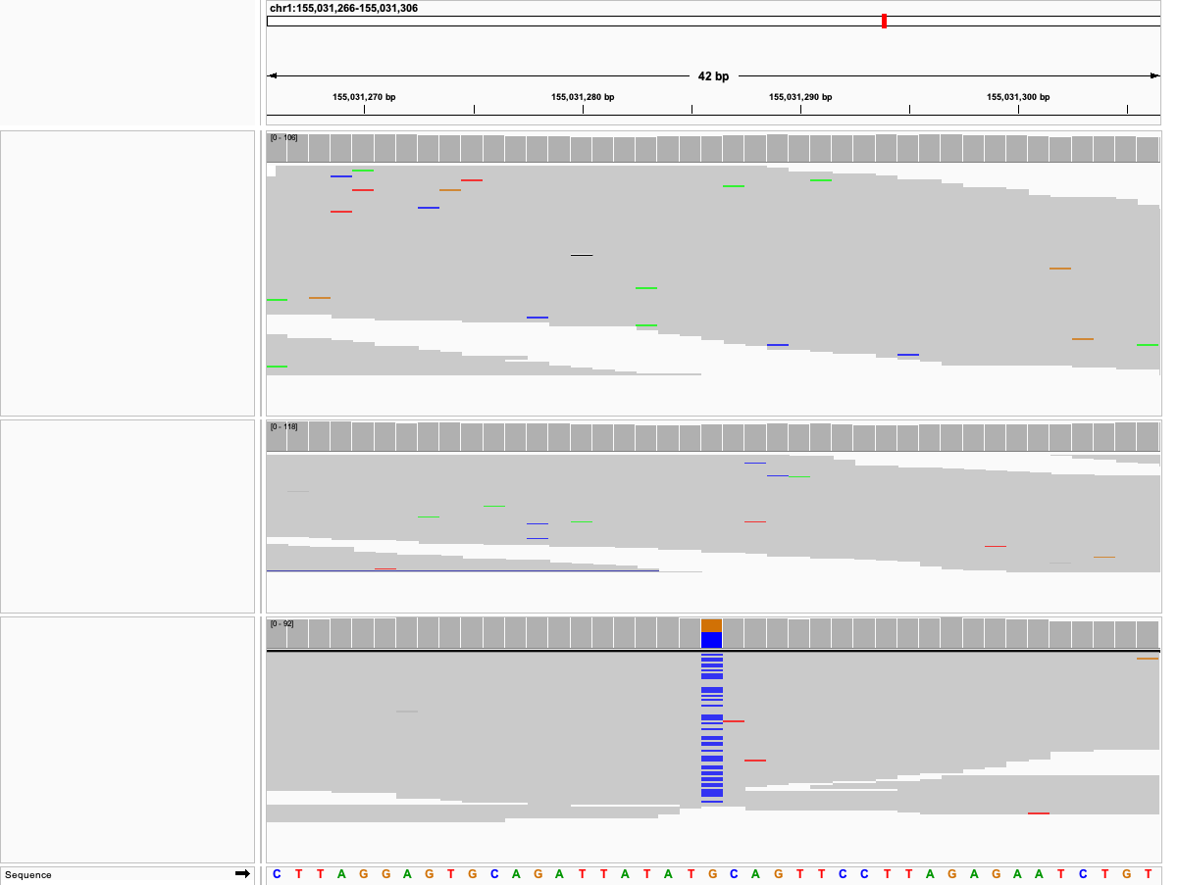
Dam
Sire
Offspring

Slide 8
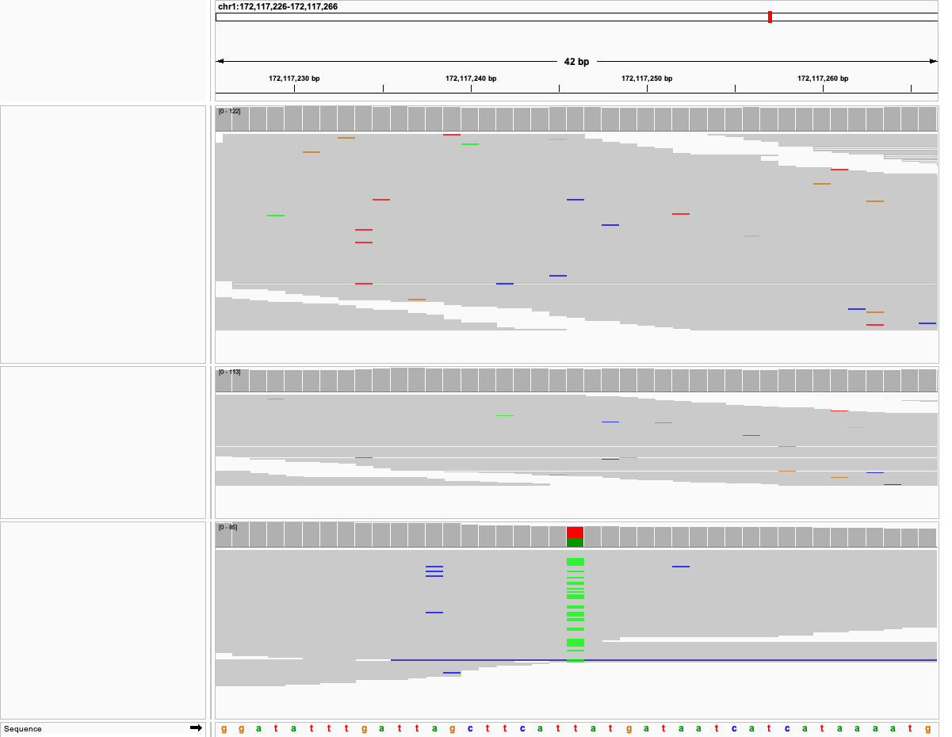
Dam
Sire
Offspring

Slide 9
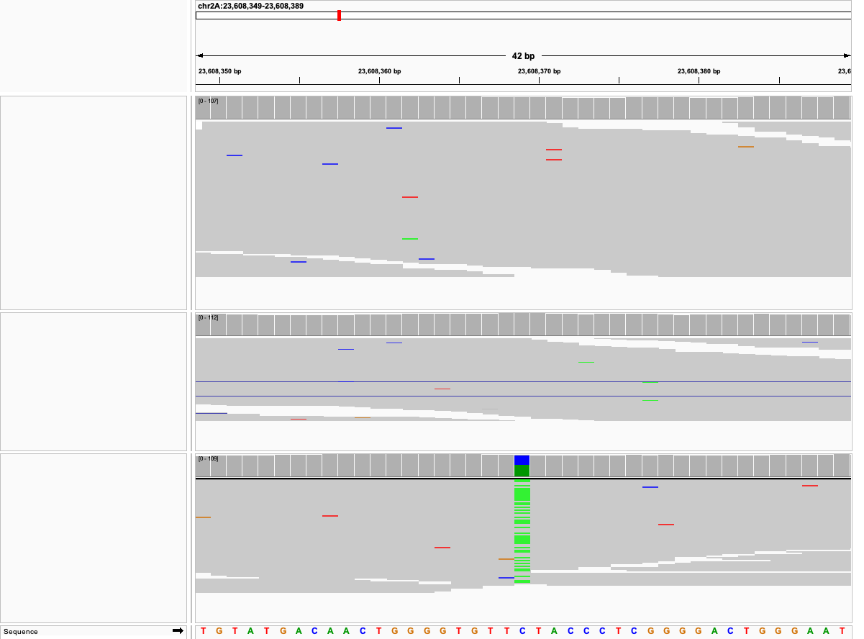
Dam
Sire
Offspring

Slide 10
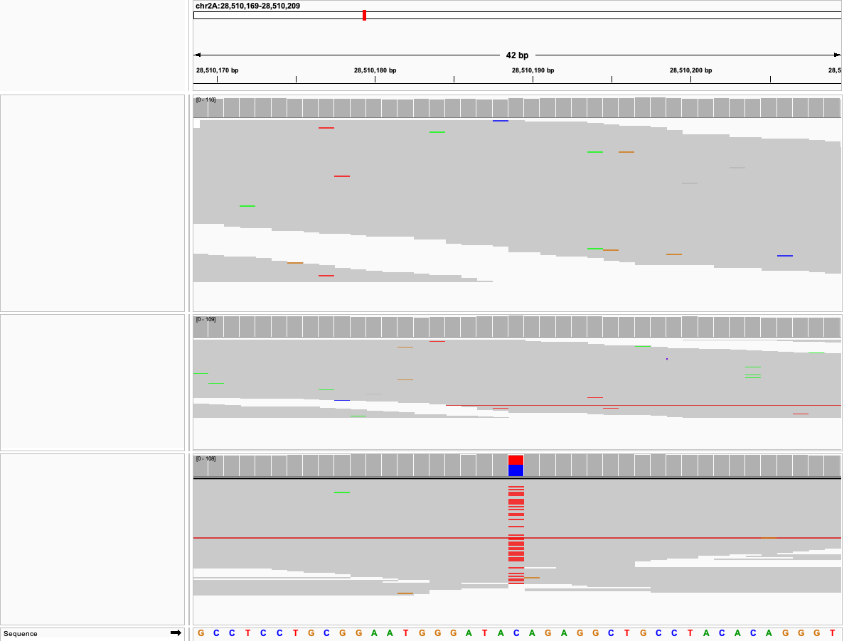
Dam
Sire
Offspring

Slide 11
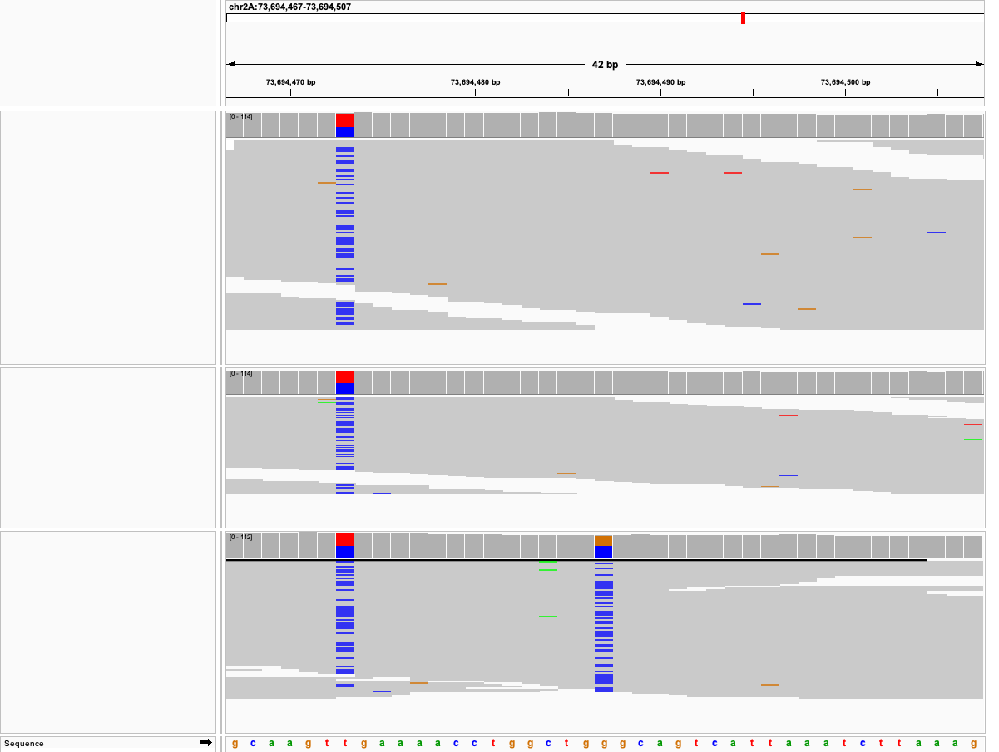
Dam
Sire
Offspring

Slide 12
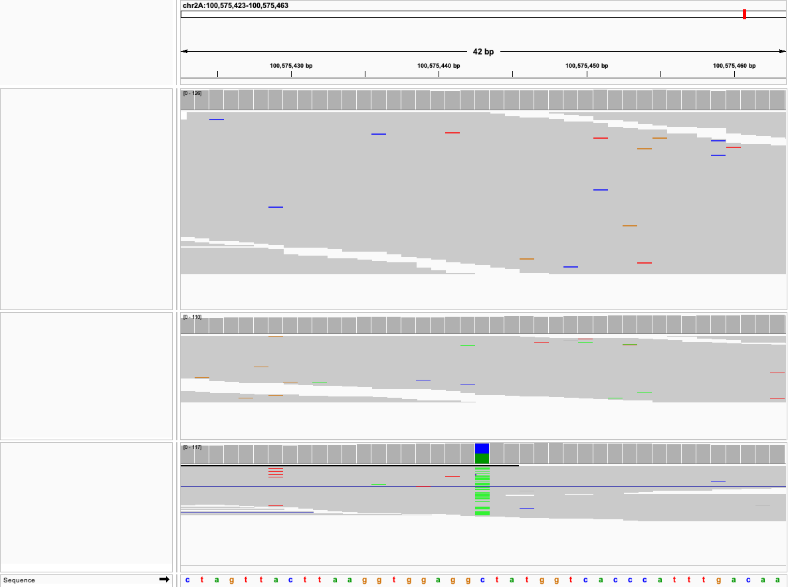
Dam
Sire
Offspring

Slide 13
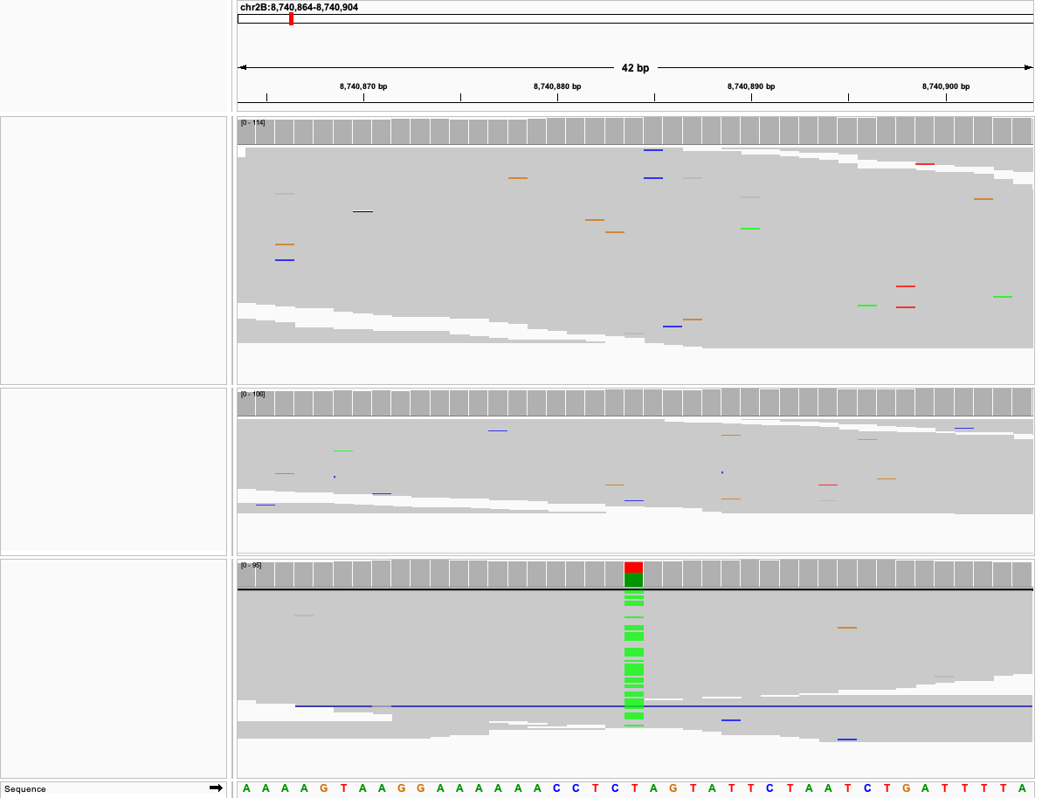
Dam
Sire
Offspring

Slide 14
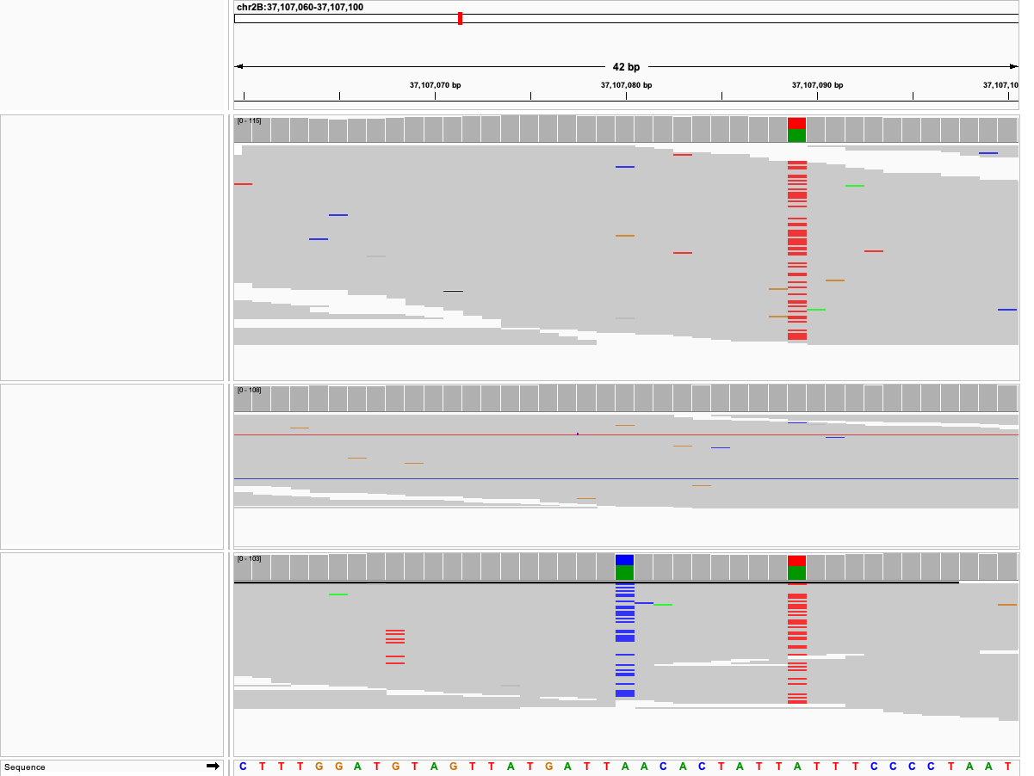
Dam
Sire
Offspring

Slide 15
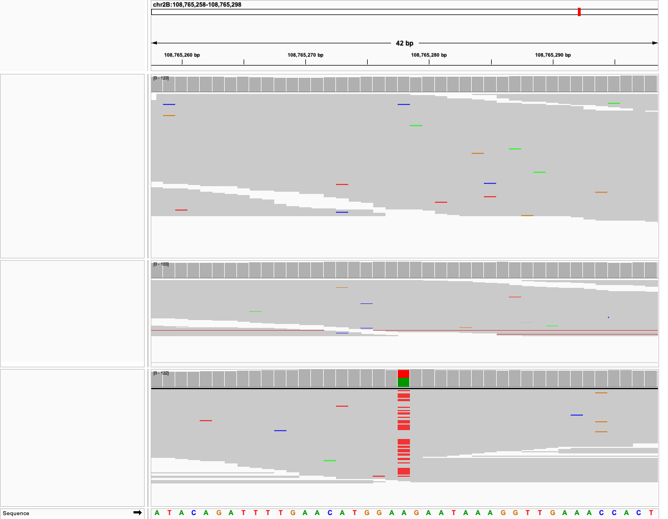
Dam
Sire
Offspring

Slide 16
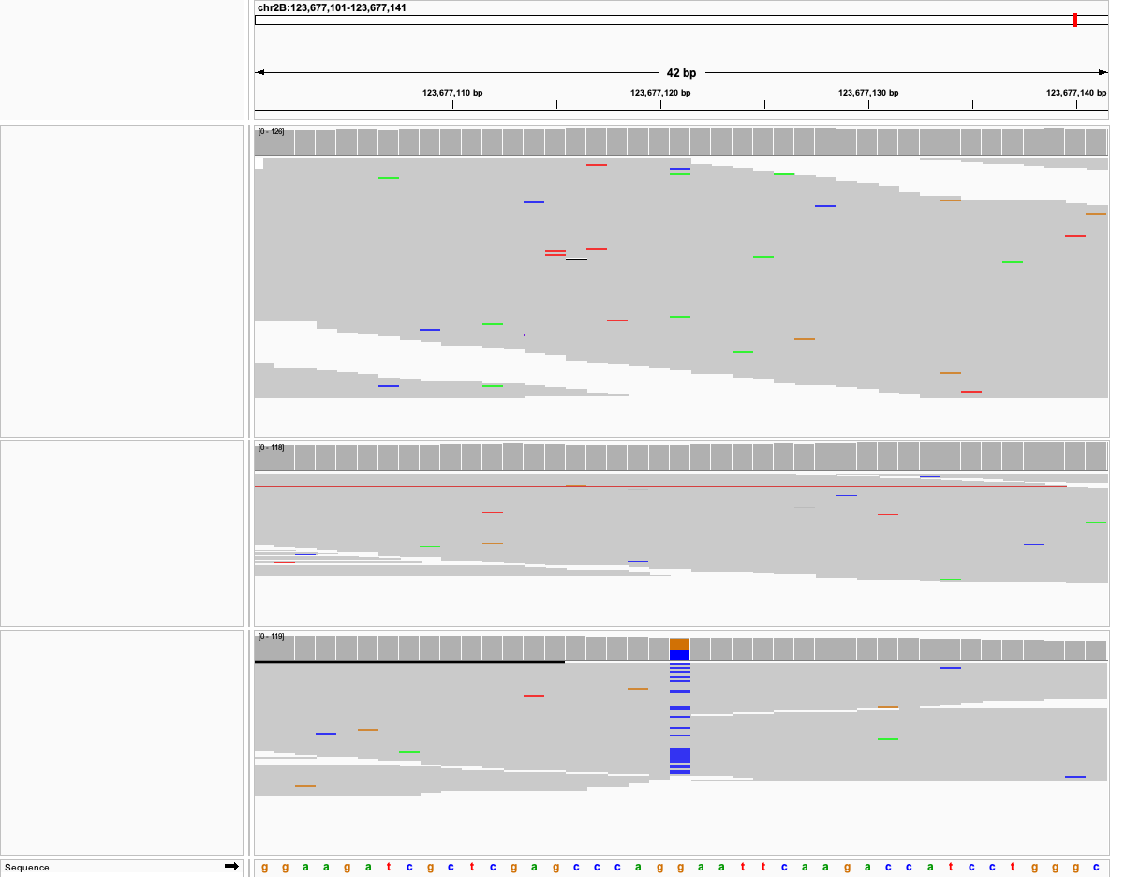
Dam
Sire
Offspring

Slide 17
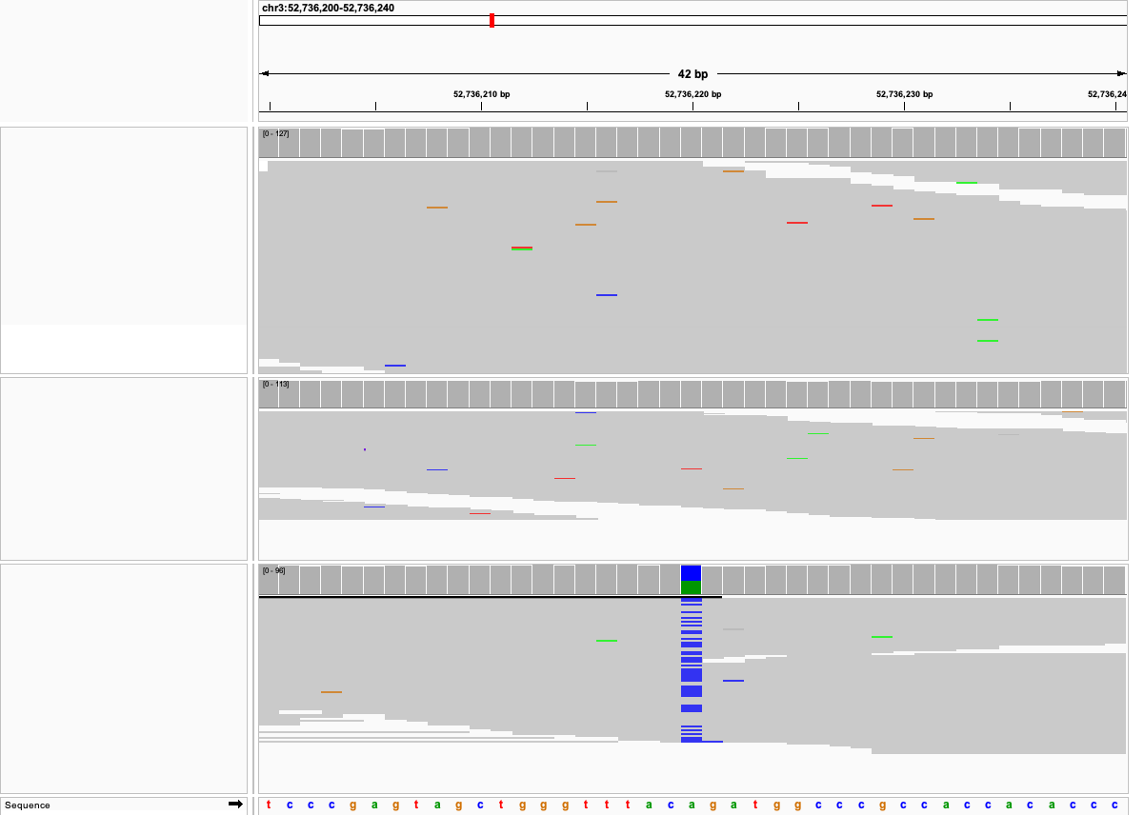
Dam
Sire
Offspring

Slide 18
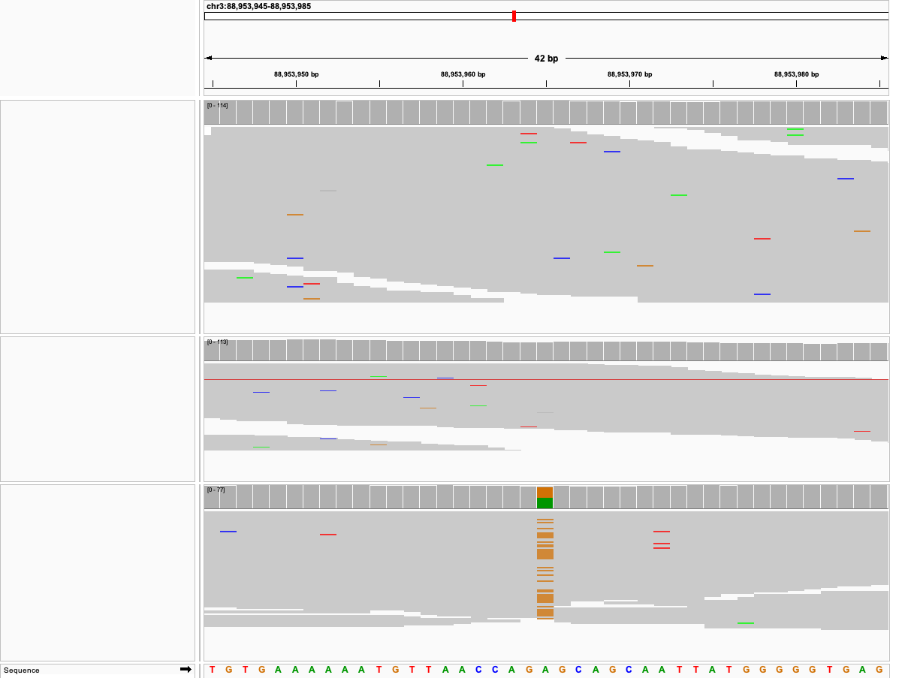
Dam
Sire
Offspring

Slide 19
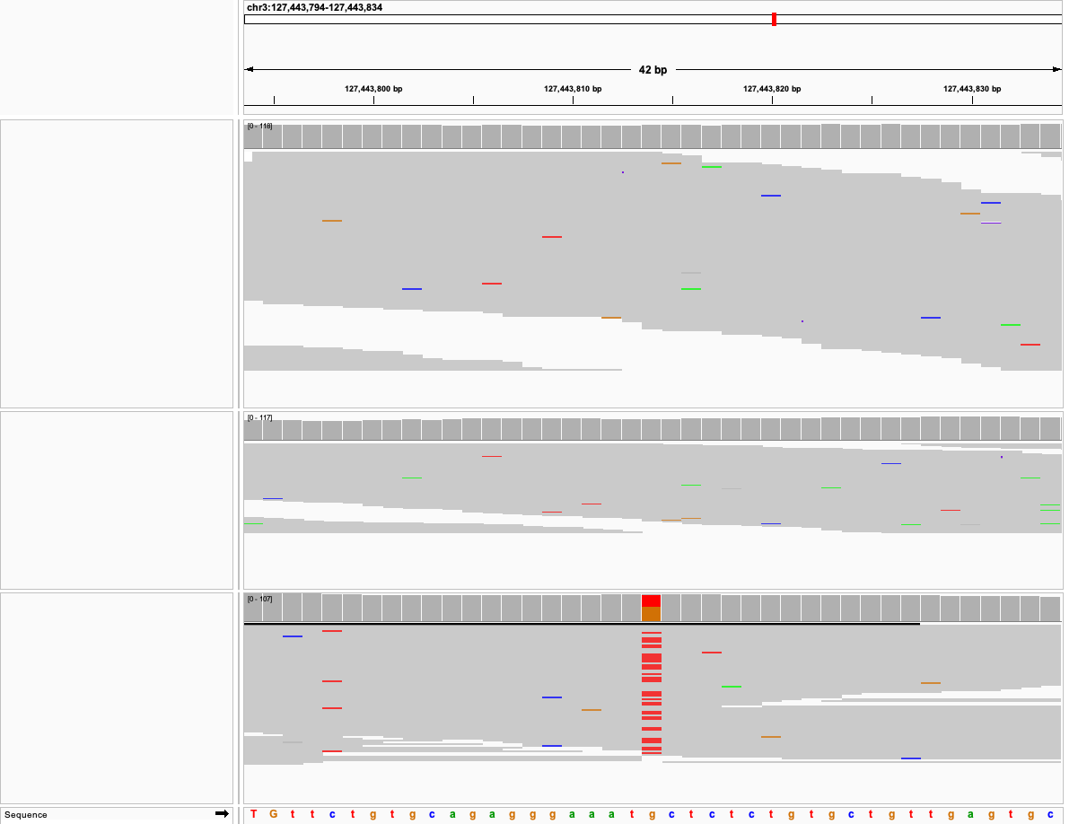
Dam
Sire
Offspring

Slide 20
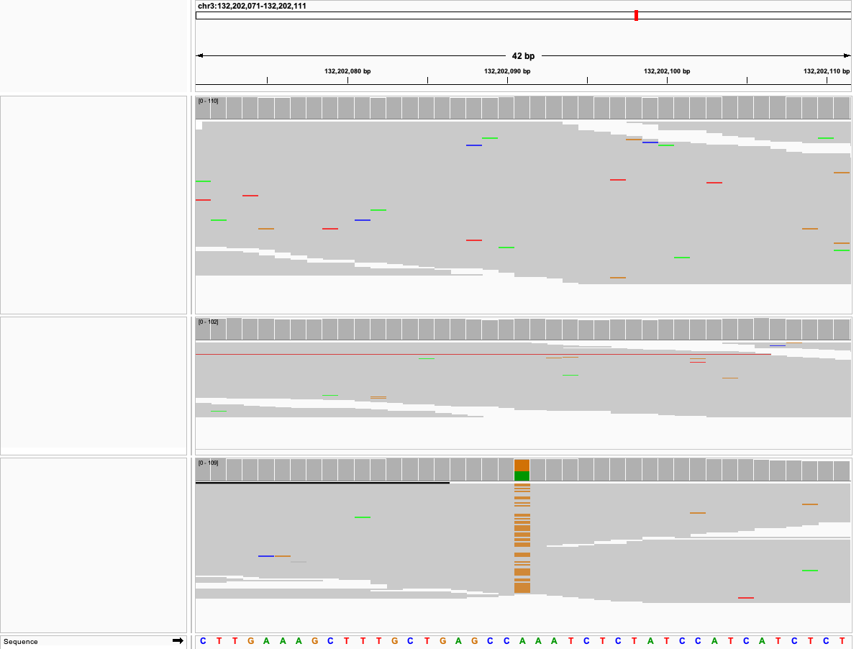
Dam
Sire
Offspring

Slide 21
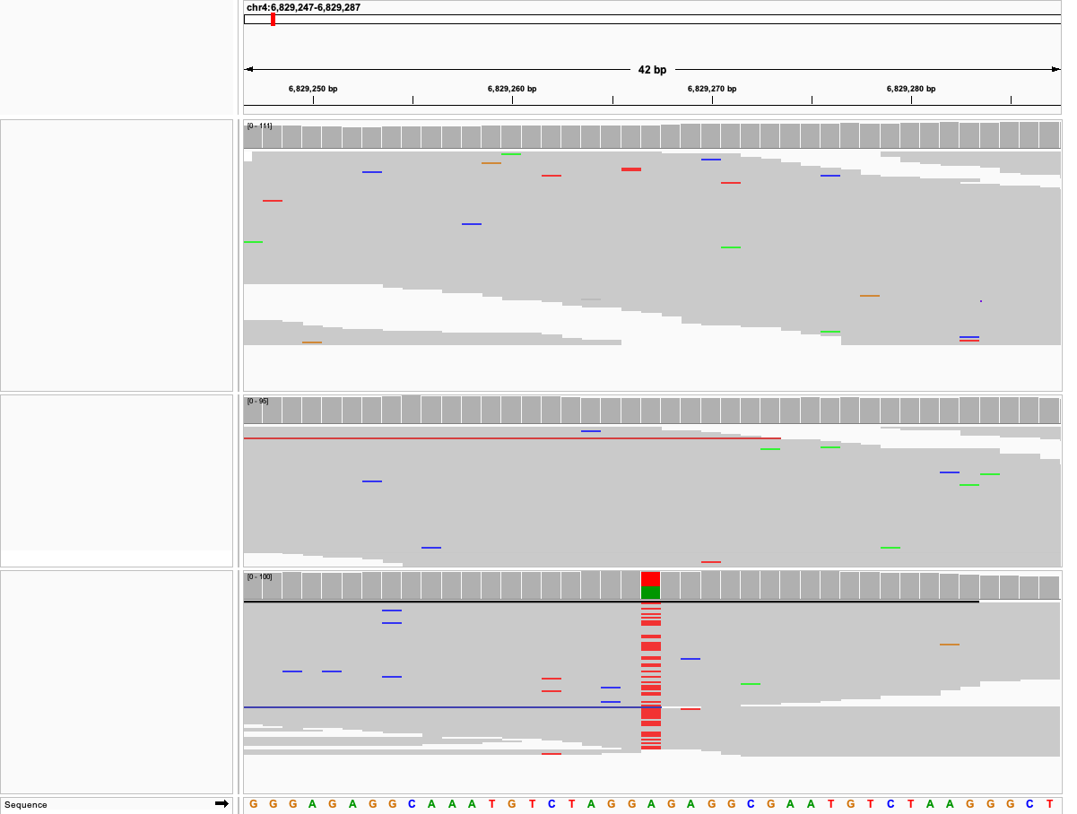
Dam
Sire
Offspring

Slide 22
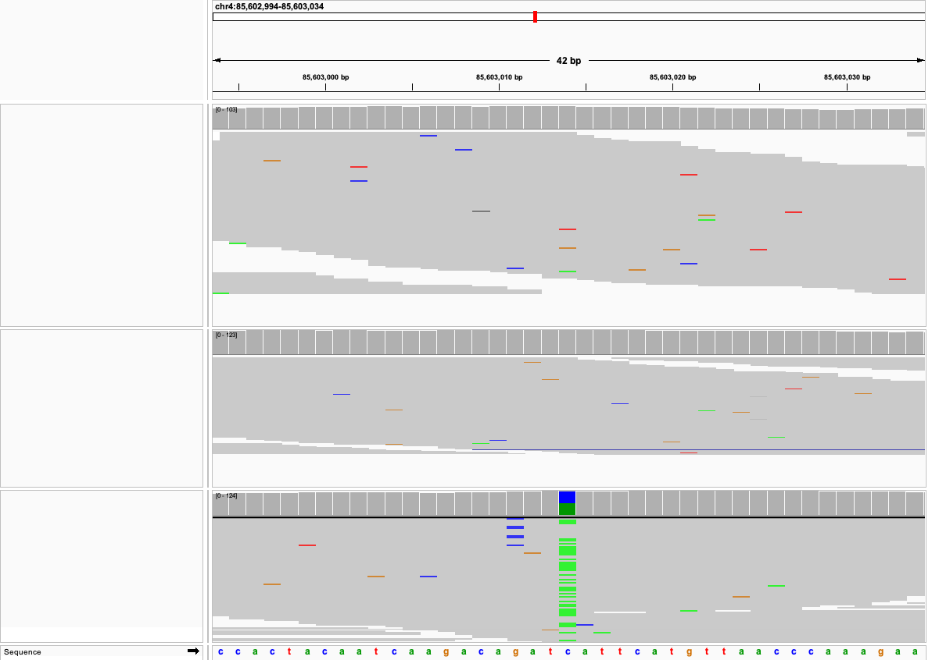
Dam
Sire
Offspring

Slide 23
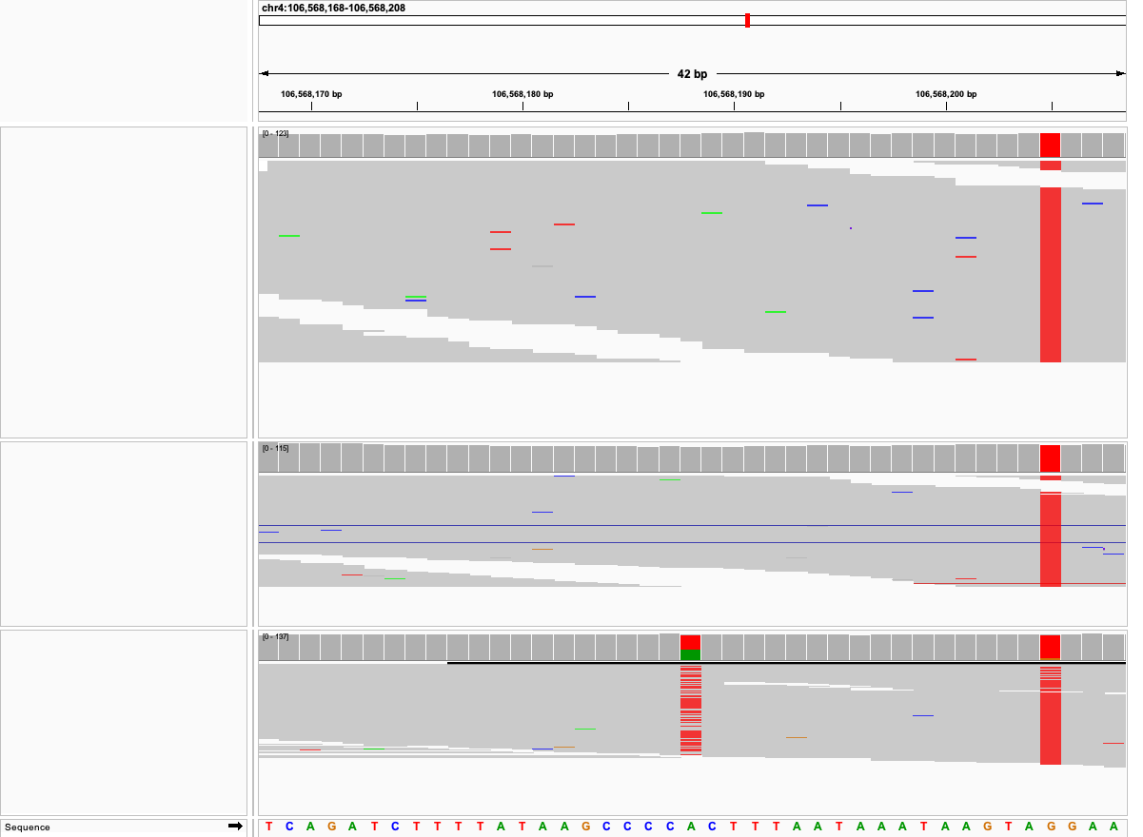
Dam
Sire
Offspring

Slide 24
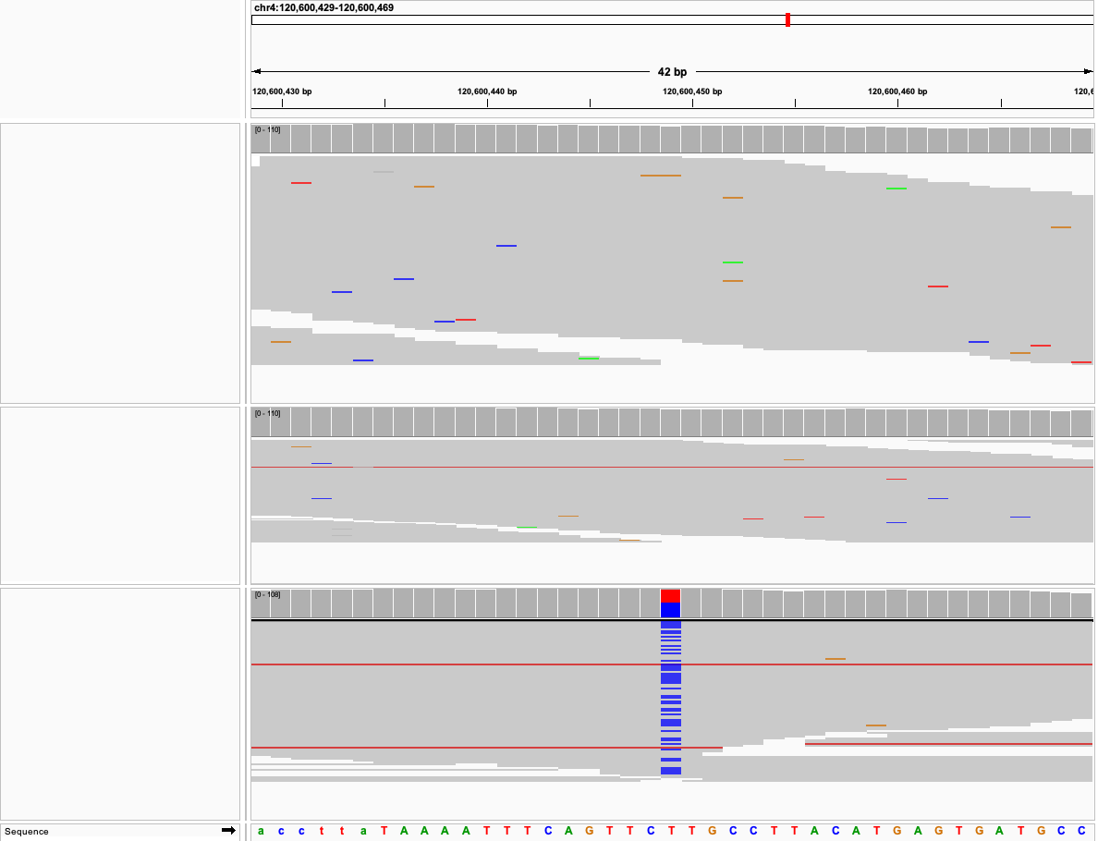
Dam
Sire
Offspring

Slide 25
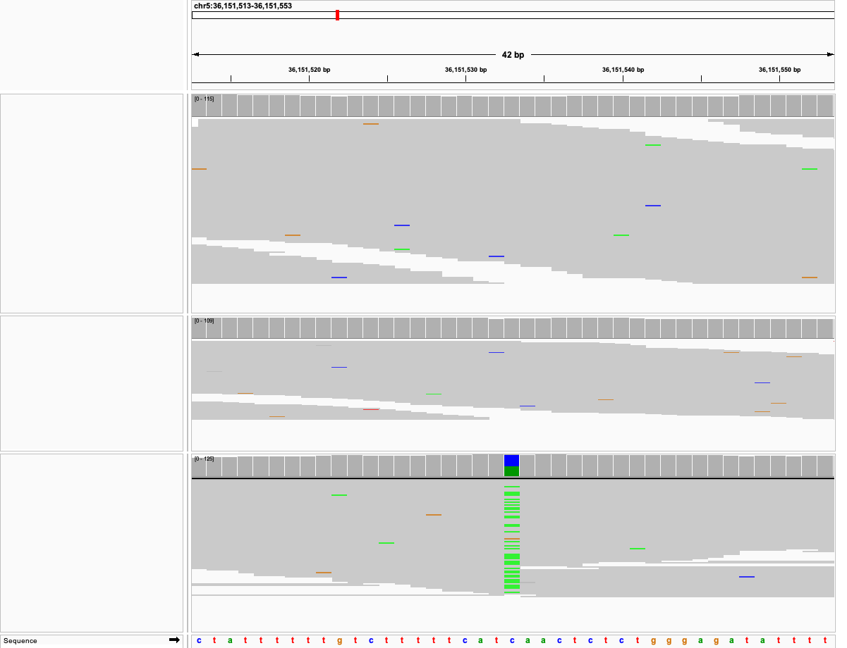
Dam
Sire
Offspring

Slide 26
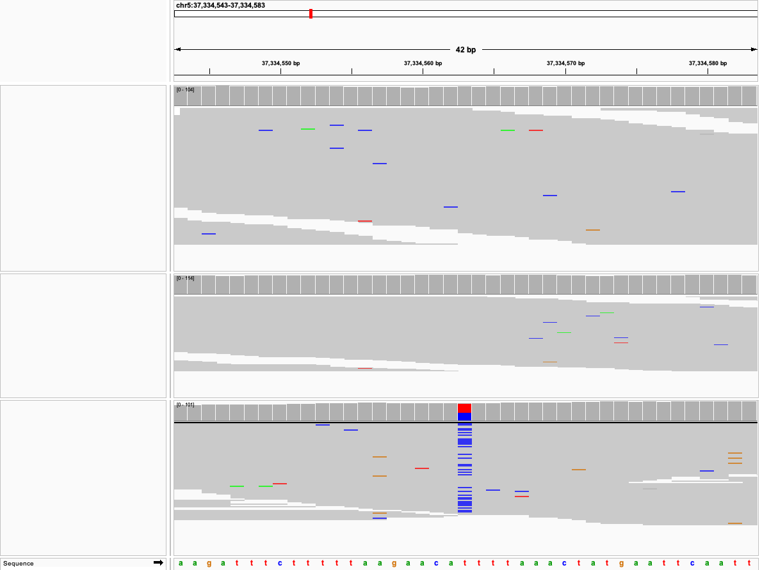
Dam
Sire
Offspring

Slide 27
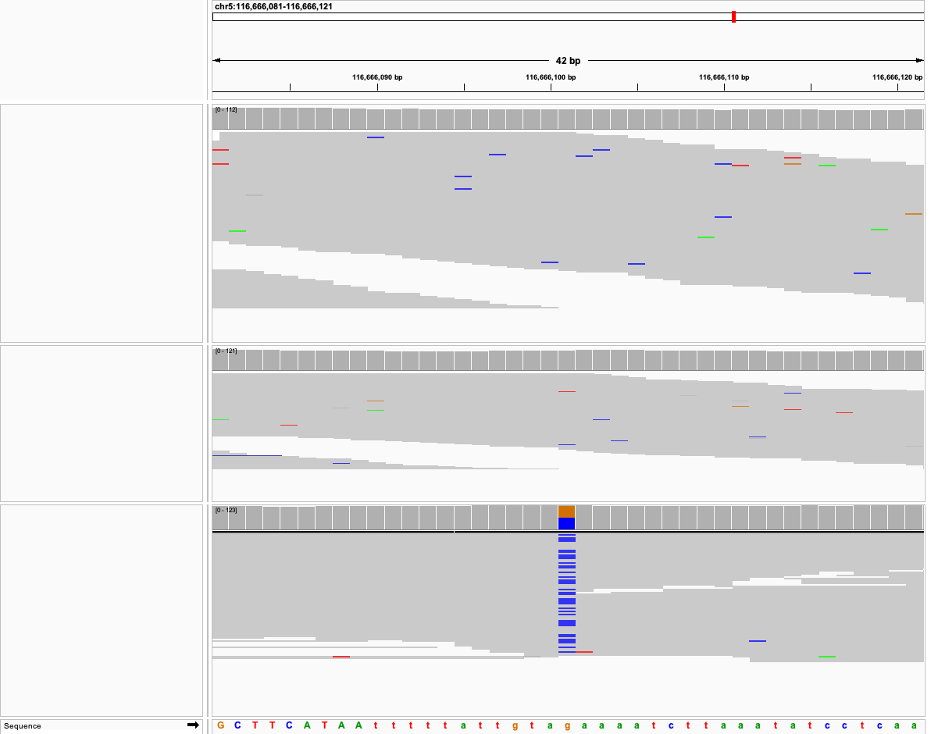
Dam
Sire
Offspring

Slide 28
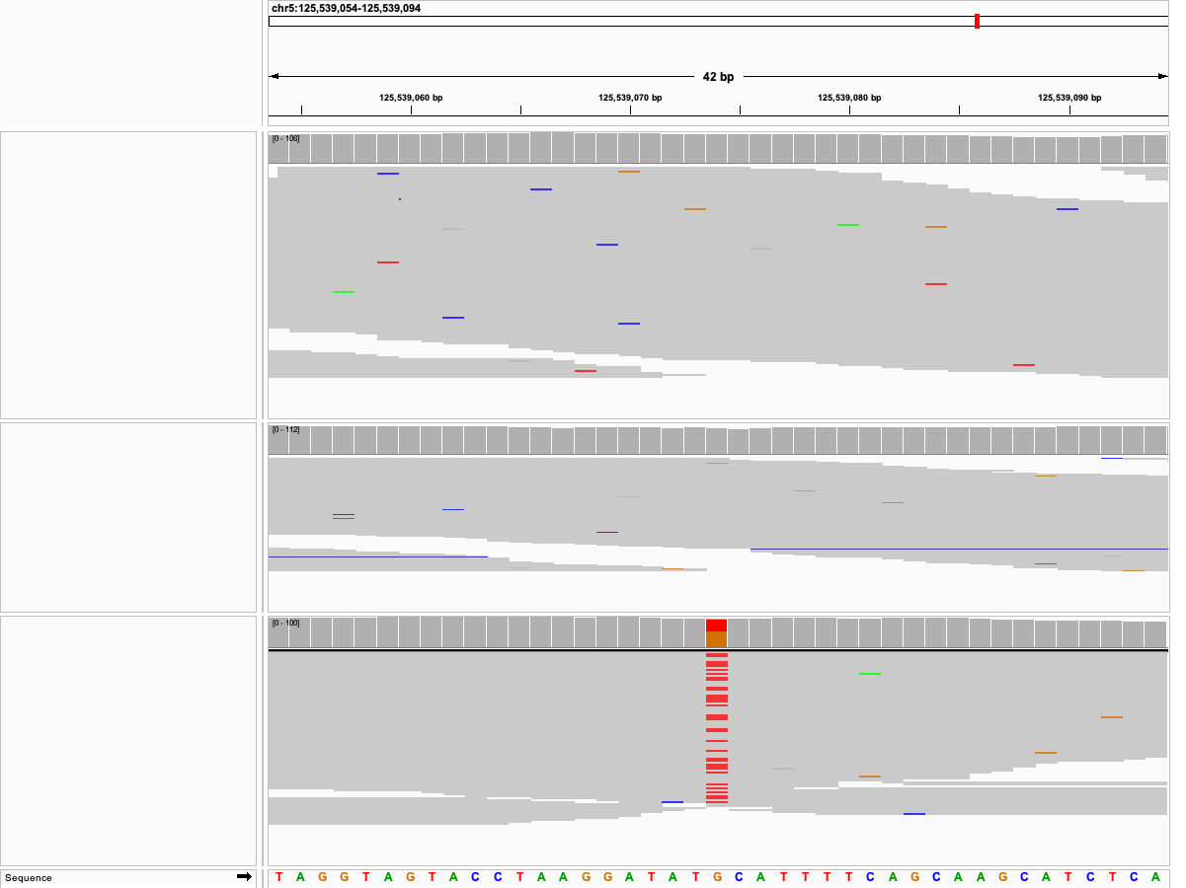
Dam
Sire
Offspring

Slide 29
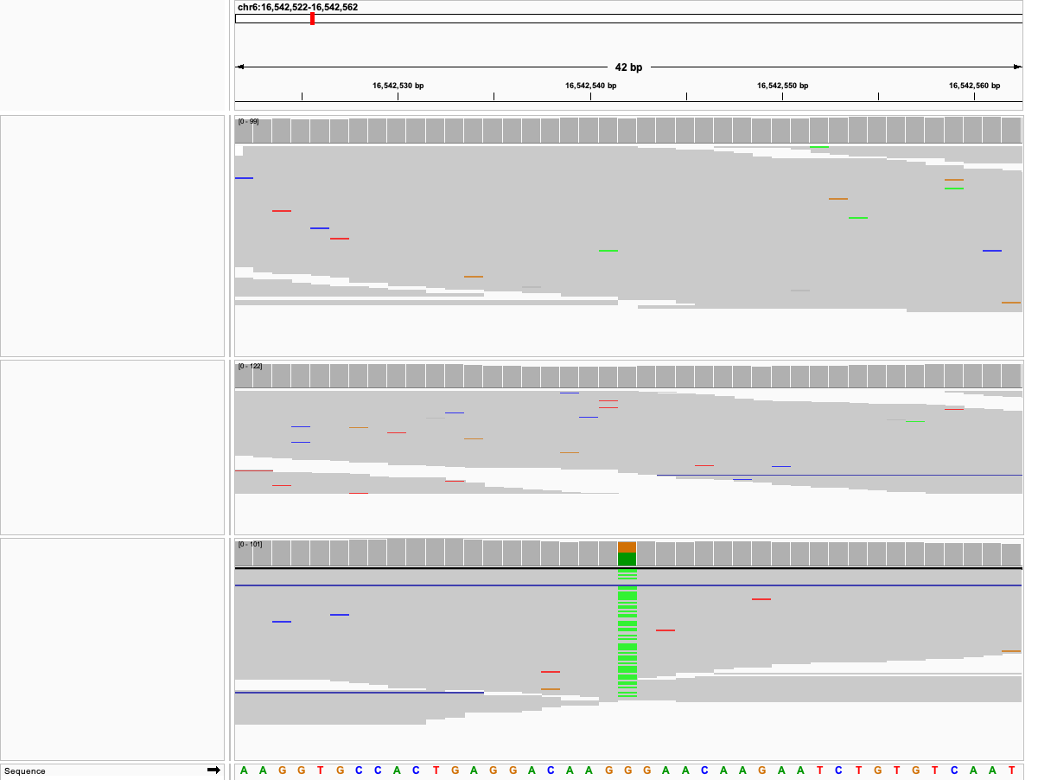
Dam
Sire
Offspring

Slide 30
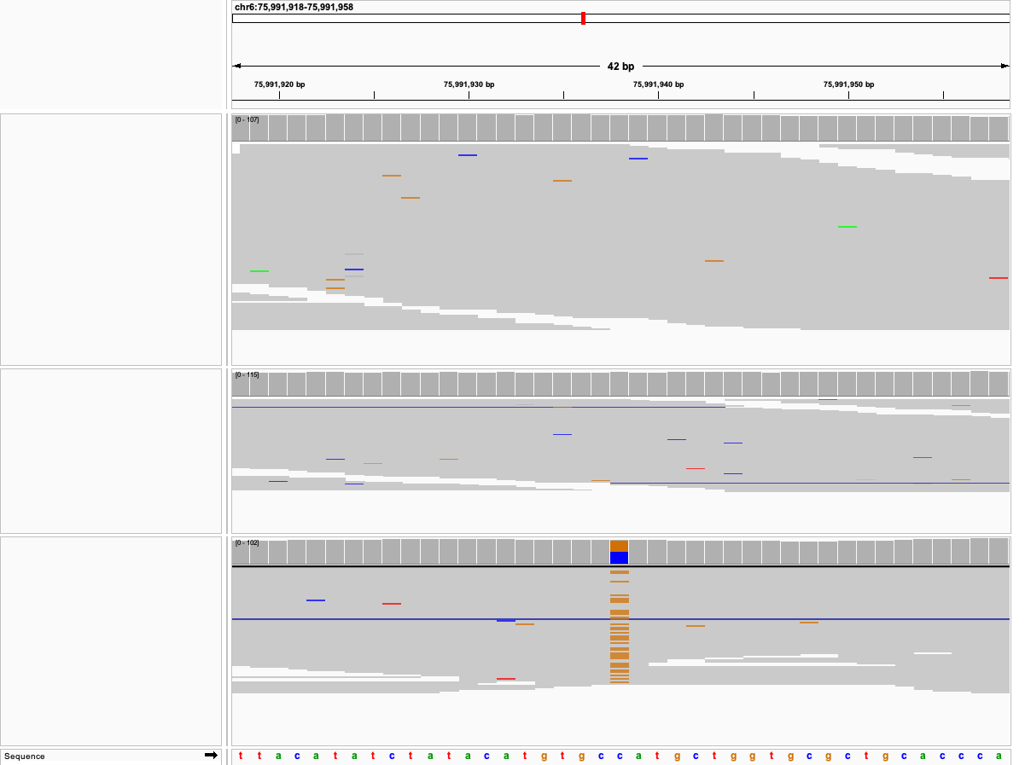
Dam
Sire
Offspring

Slide 31
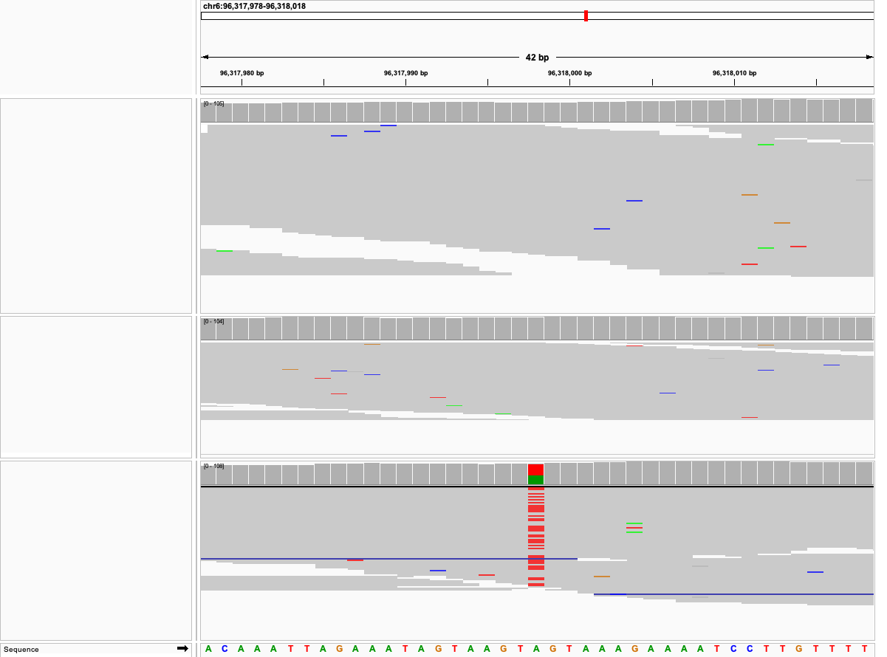
Dam
Sire
Offspring

Slide 32
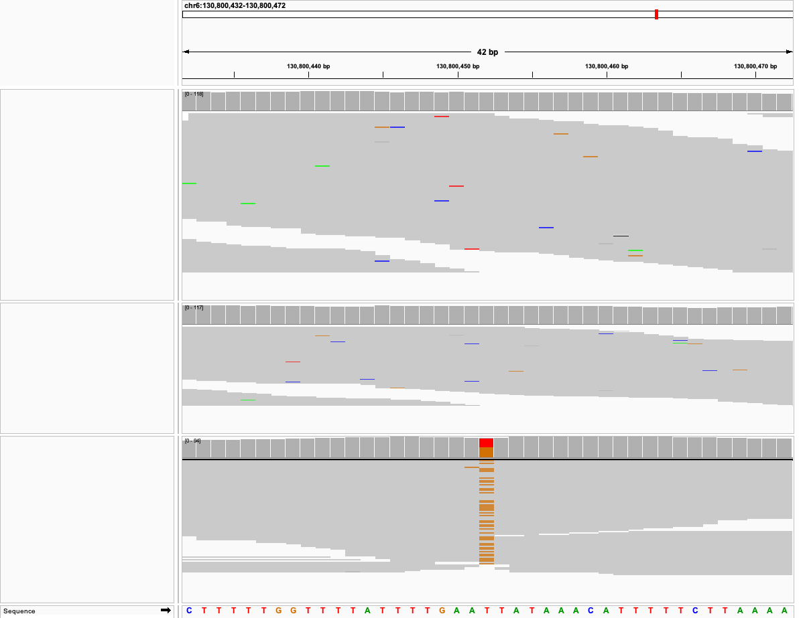
Dam
Sire
Offspring

Slide 33
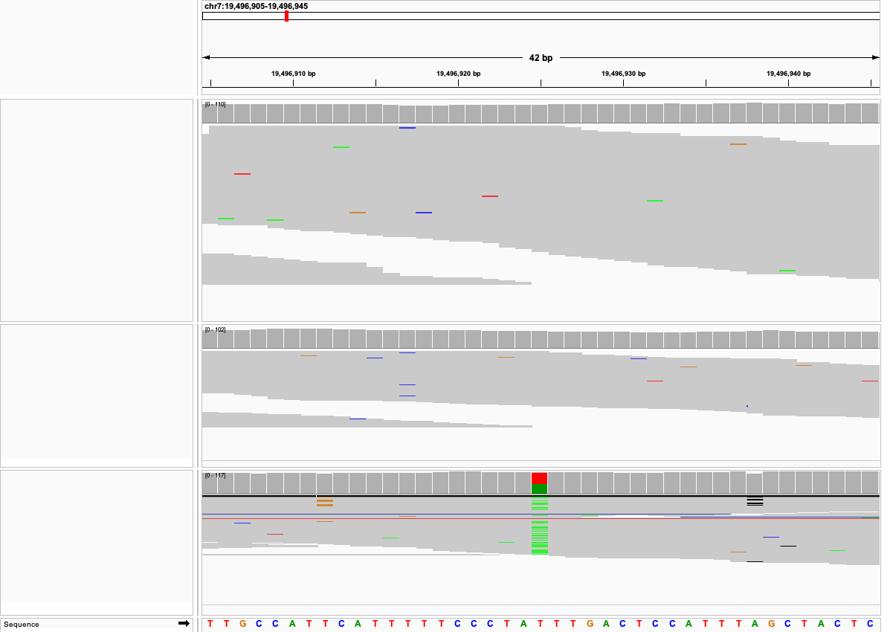
Dam
Sire
Offspring

Slide 34
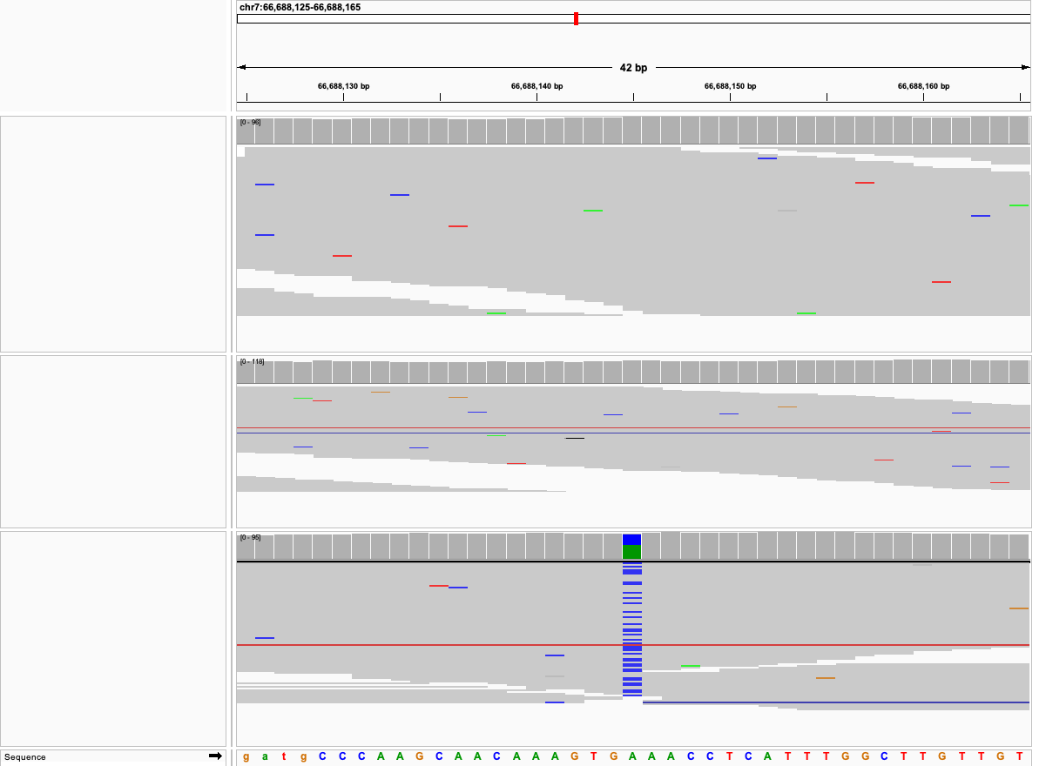
Dam
Sire
Offspring

Slide 35
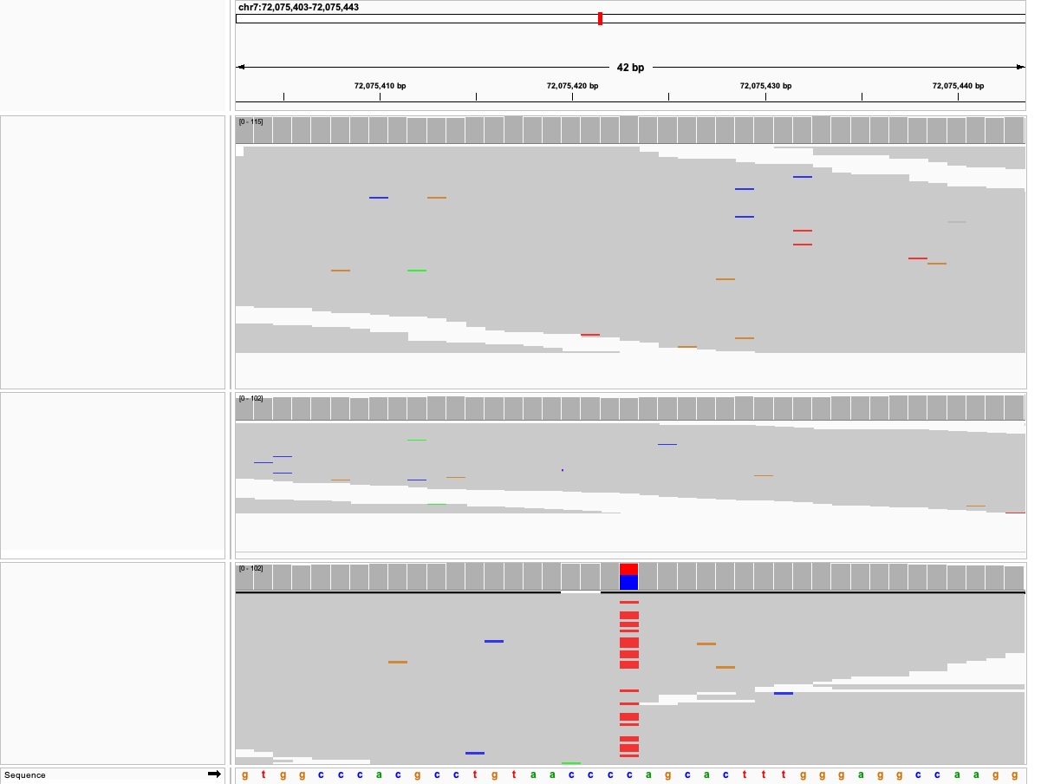
Dam
Sire
Offspring

Slide 36
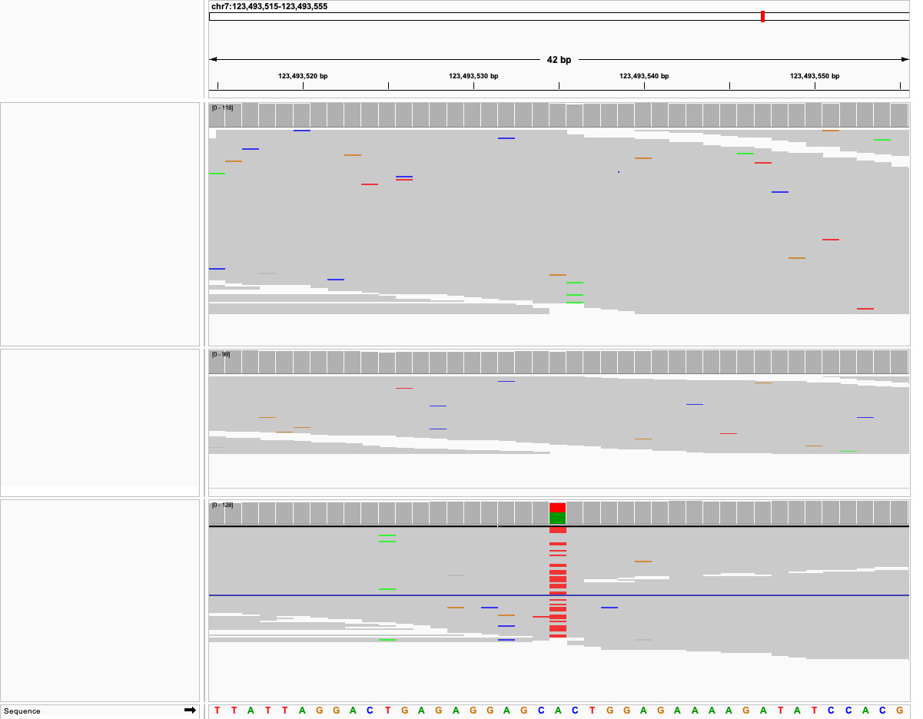
Dam
Sire
Offspring

Slide 37
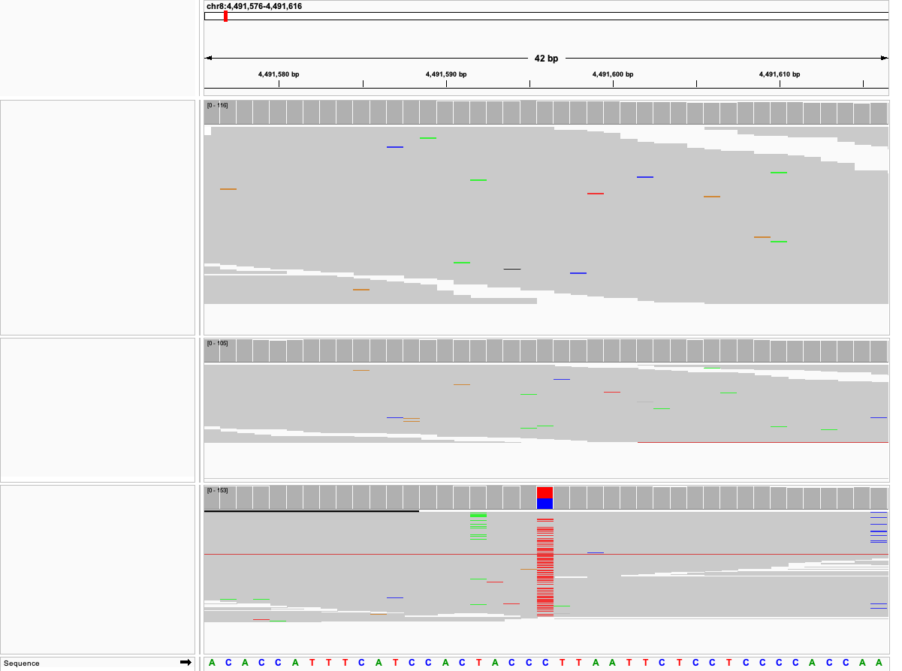
Dam
Sire
Offspring

Slide 38
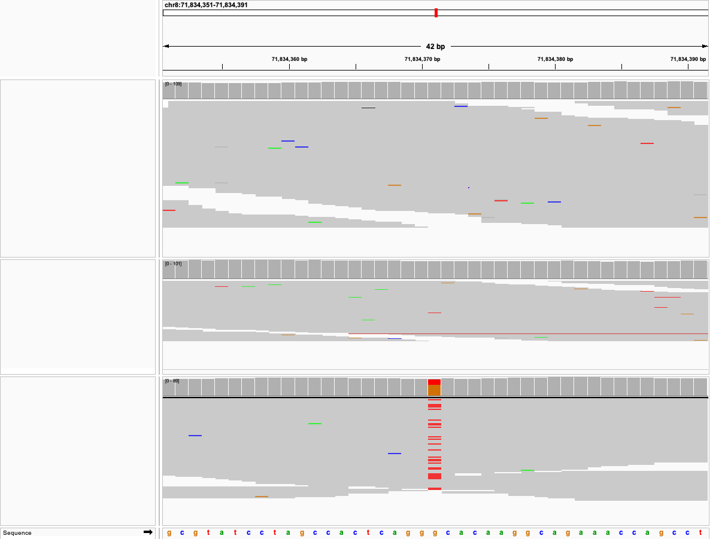
Dam
Sire
Offspring

Slide 39
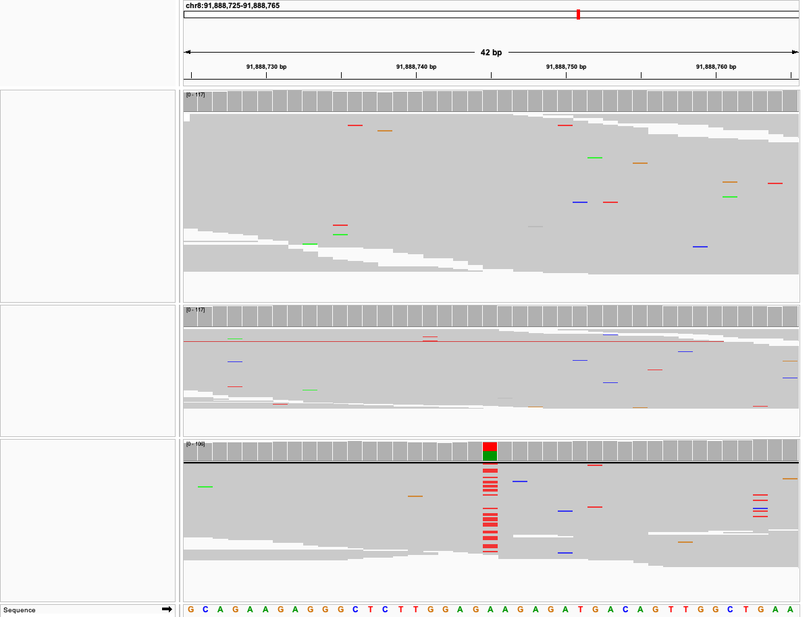
Dam
Sire
Offspring

Slide 40
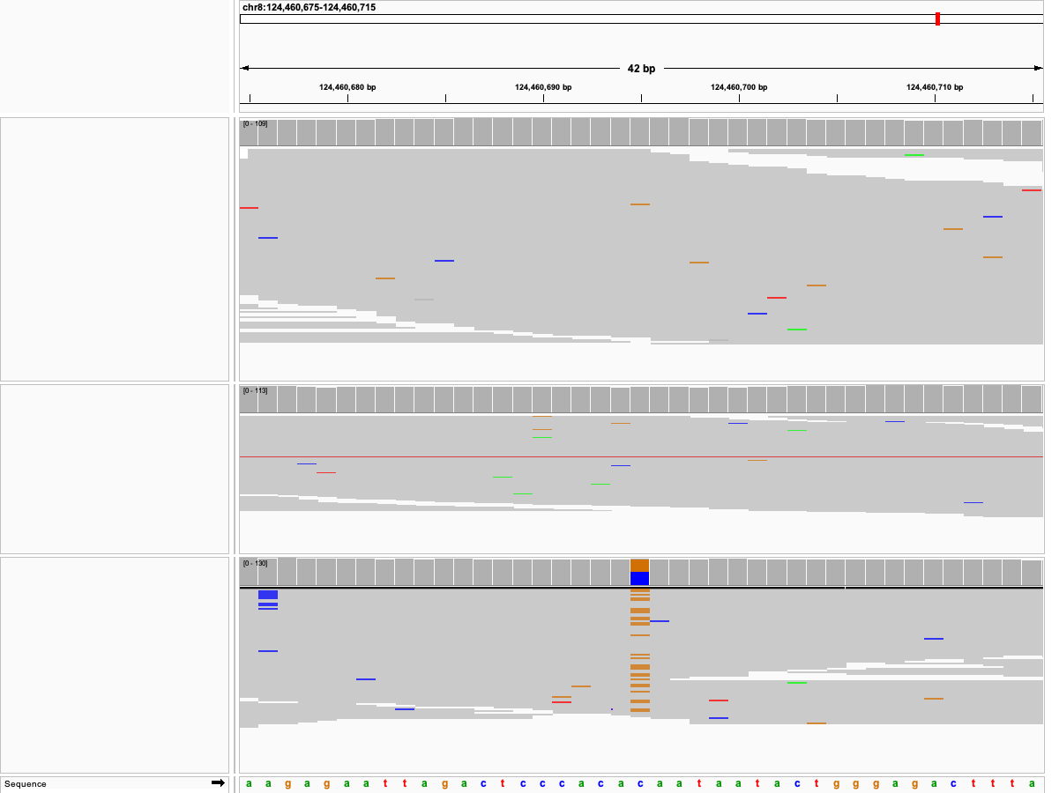
Dam
Sire
Offspring

Slide 41
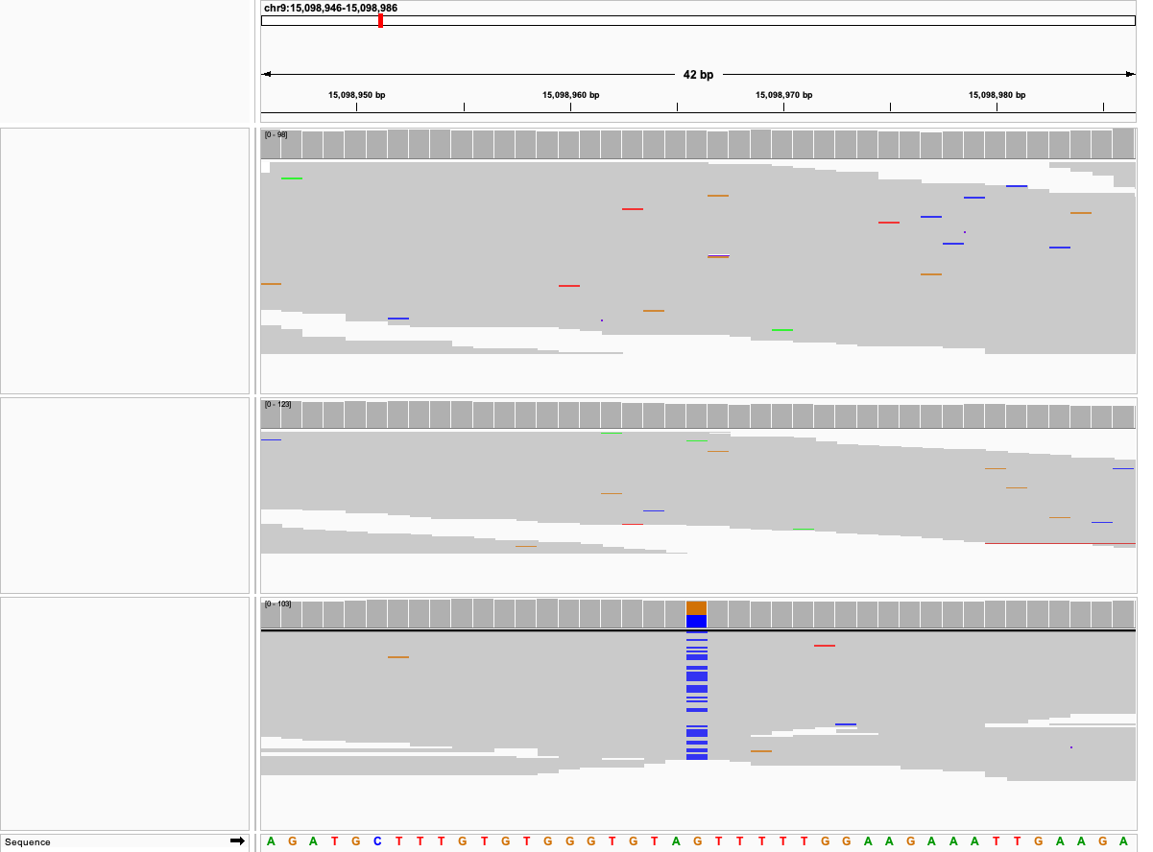
Dam
Sire
Offspring

Slide 42
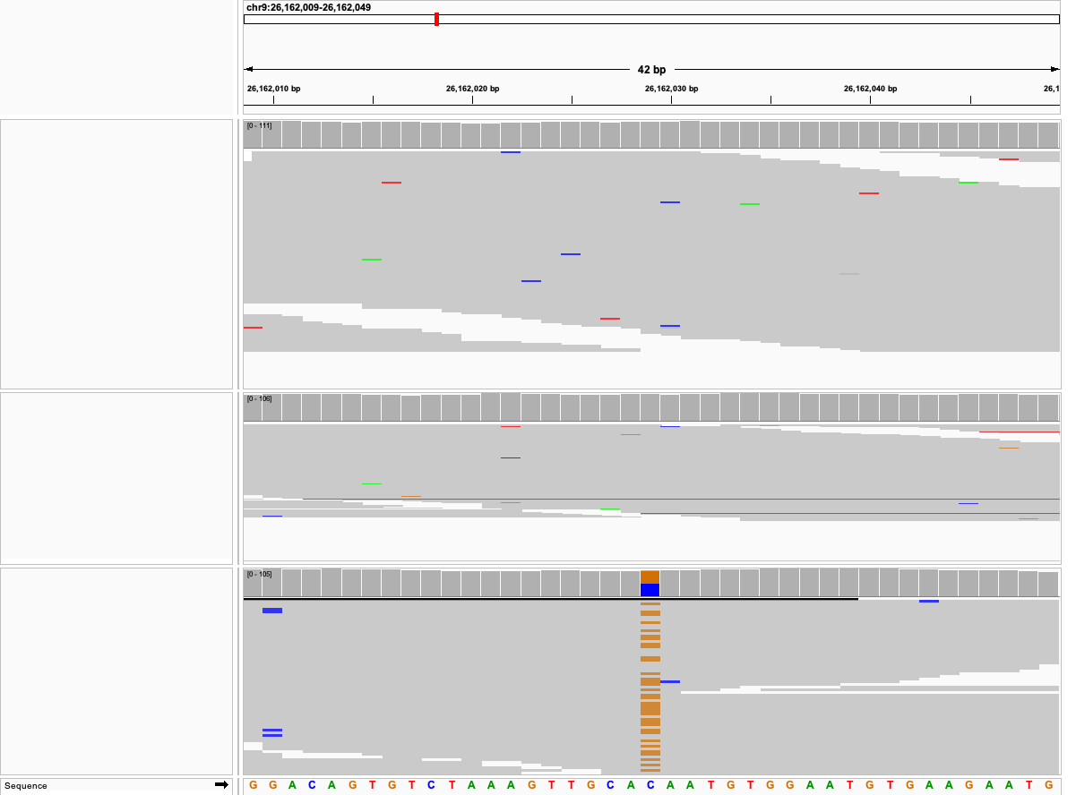
Dam
Sire
Offspring

Slide 43
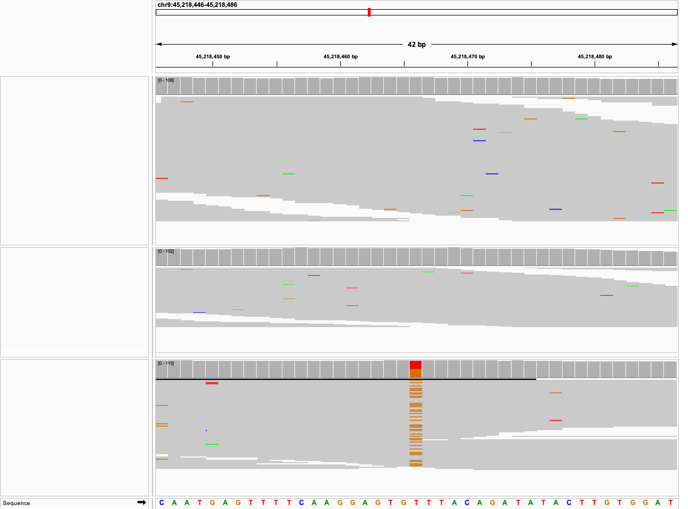
Dam
Sire
Offspring

Slide 44
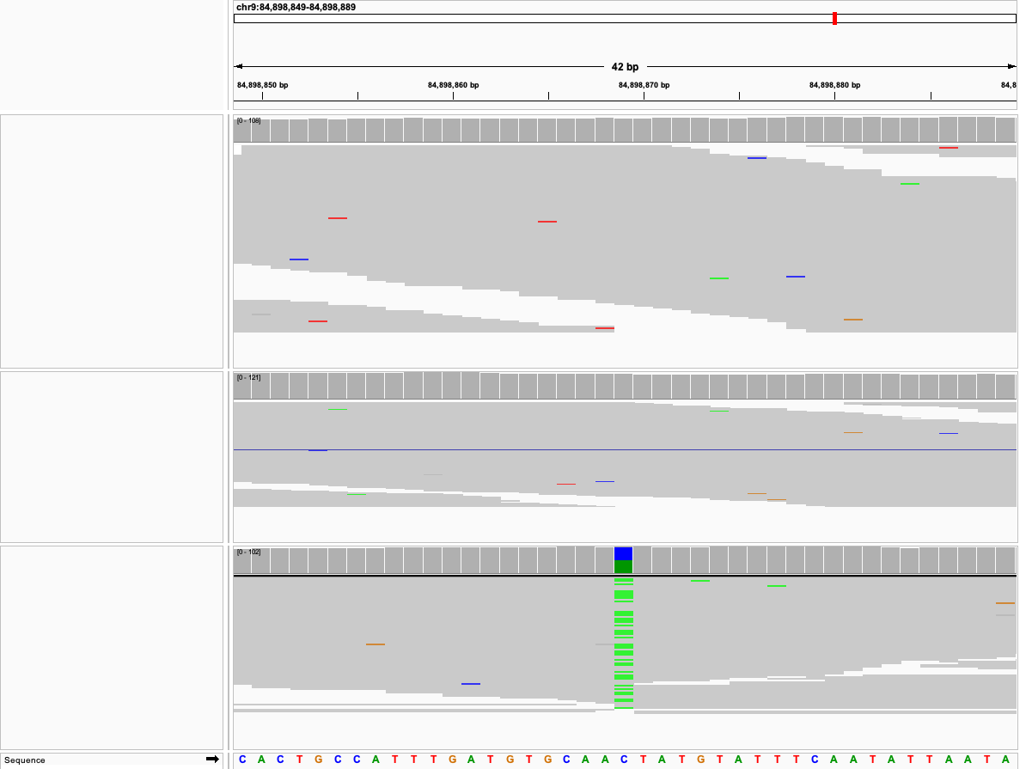
Dam
Sire
Offspring

Slide 45
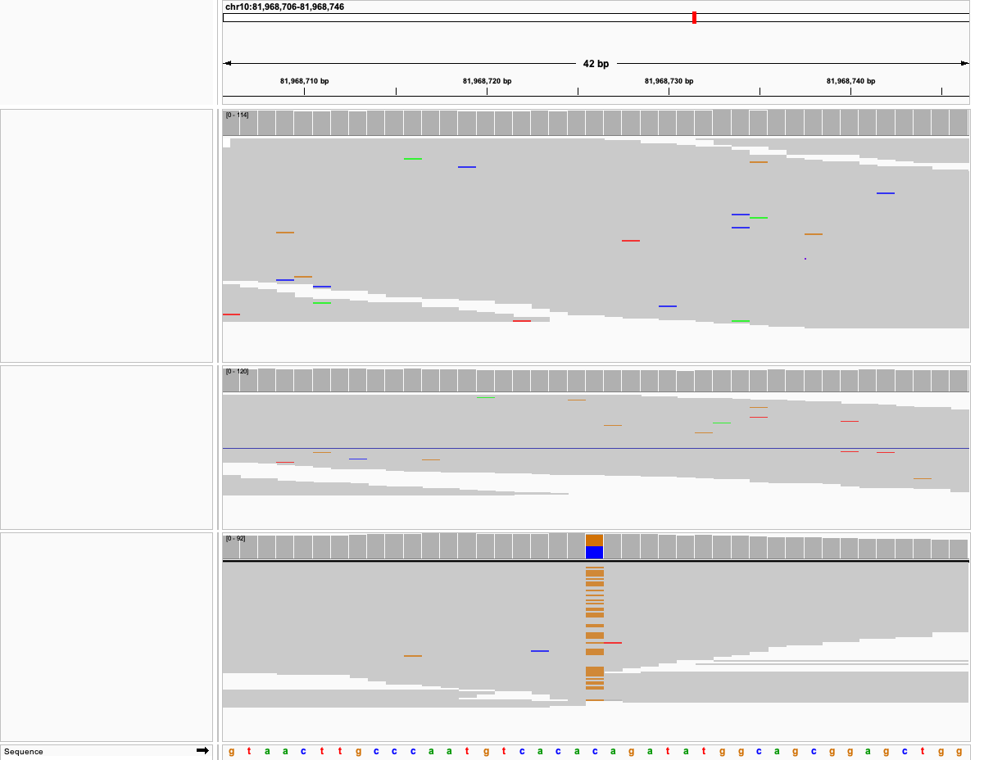
Dam
Sire
Offspring

Slide 46
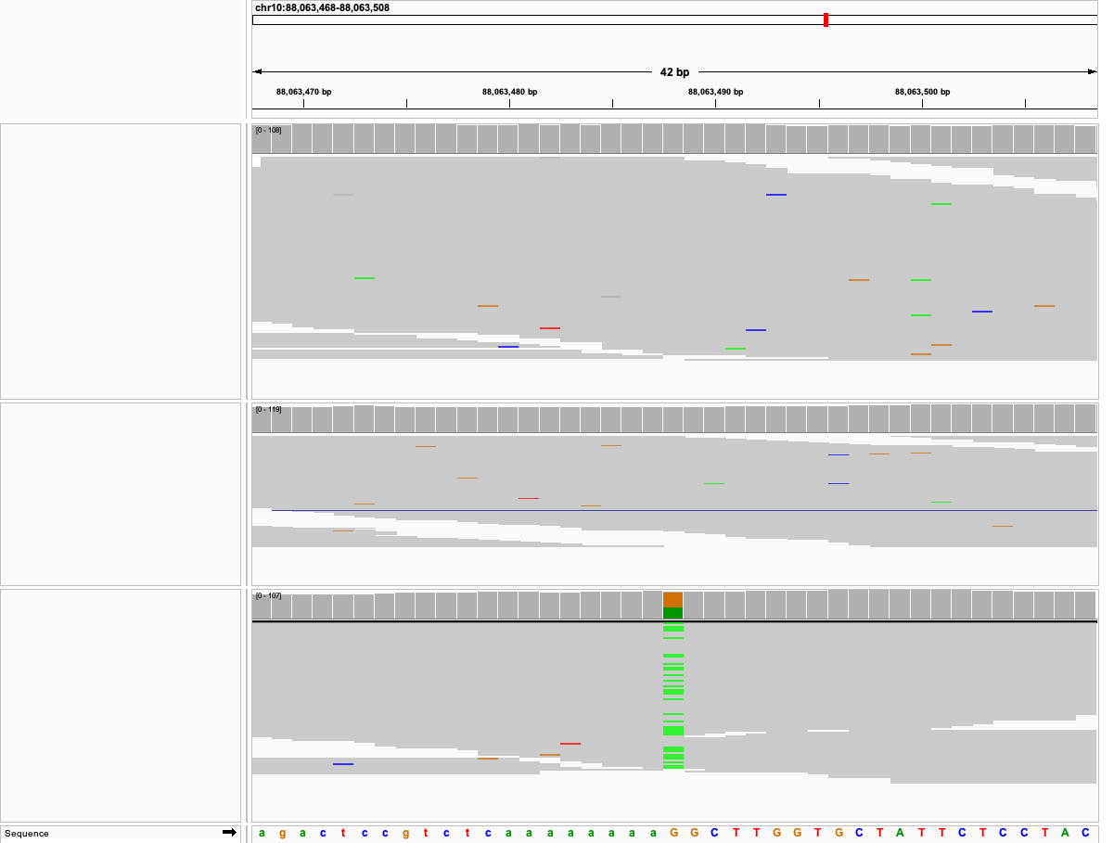
Dam
Sire
Offspring

Slide 47
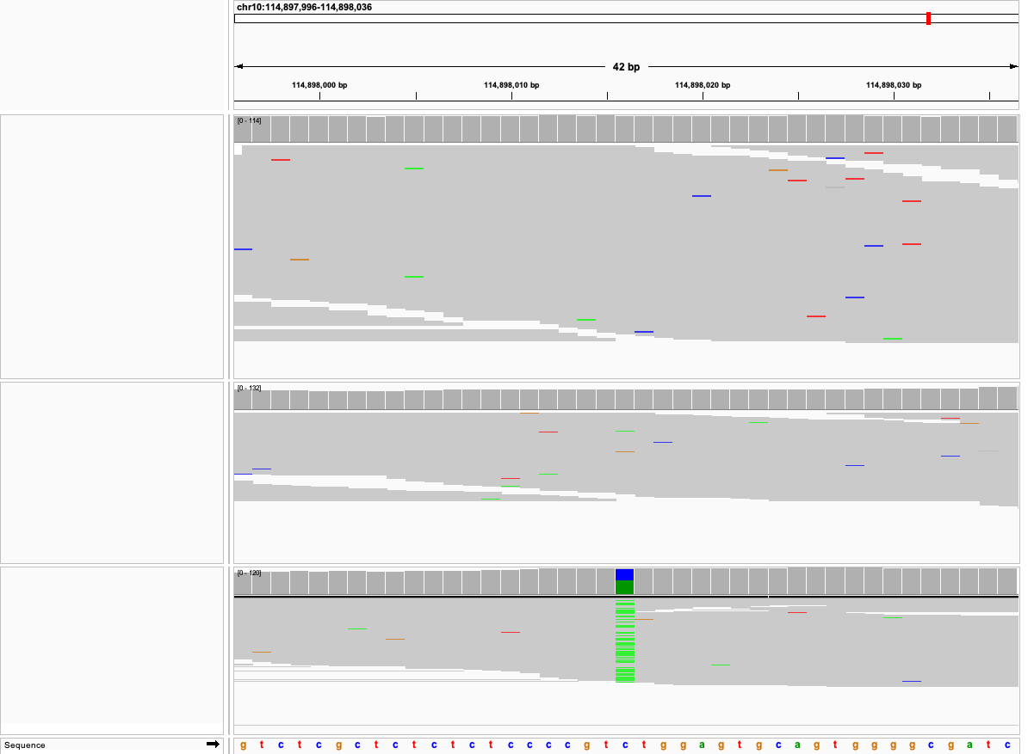
Dam
Sire
Offspring

Slide 48
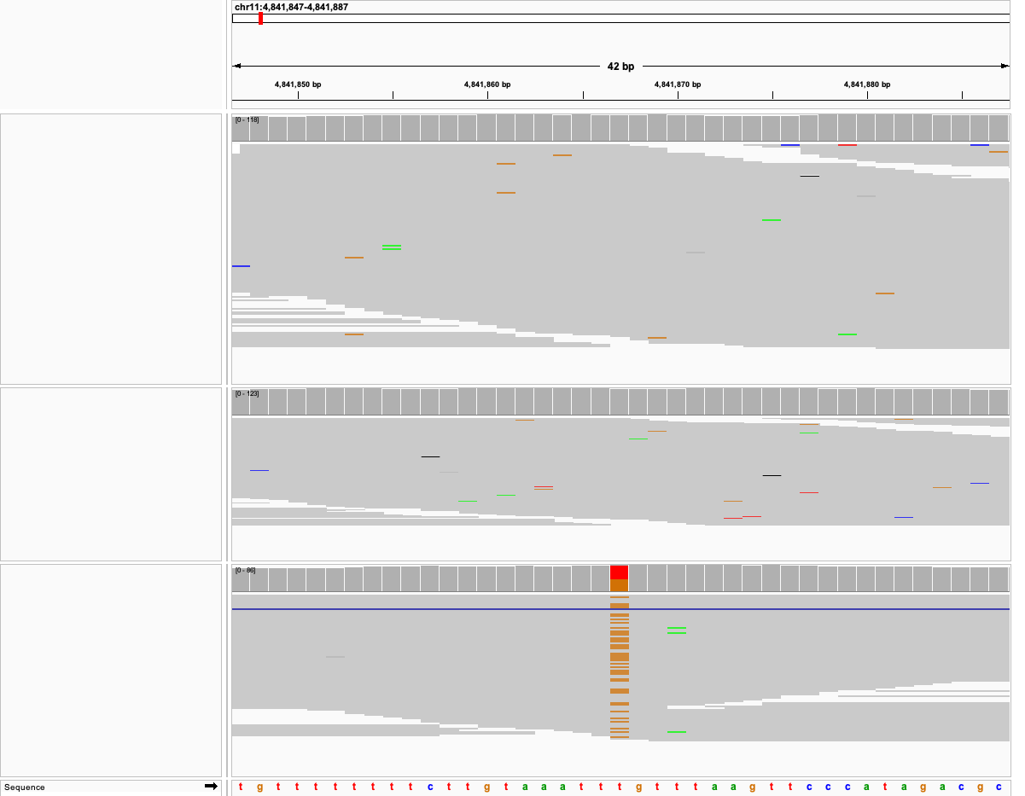
Dam
Sire
Offspring

Slide 49
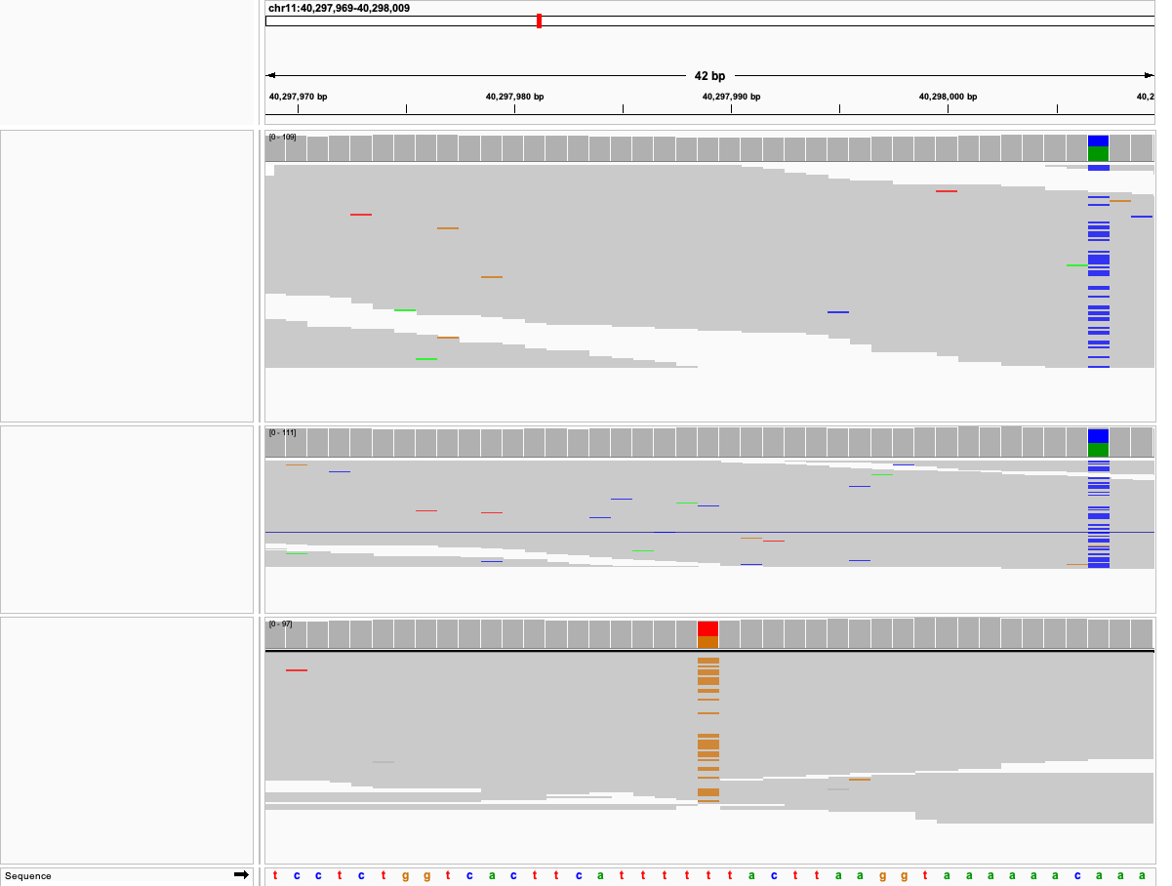
Dam
Sire
Offspring

Slide 50
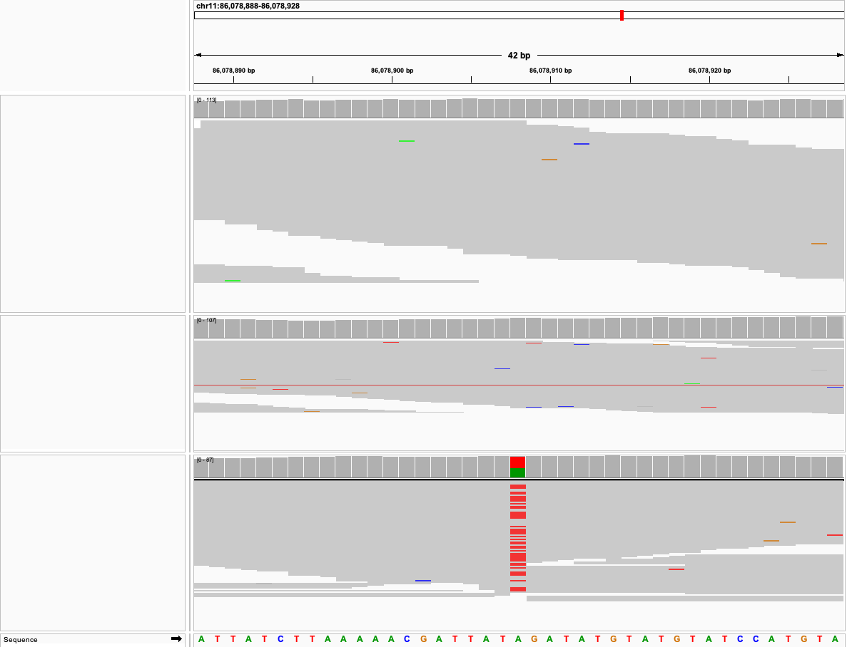
Dam
Sire
Offspring

Slide 51
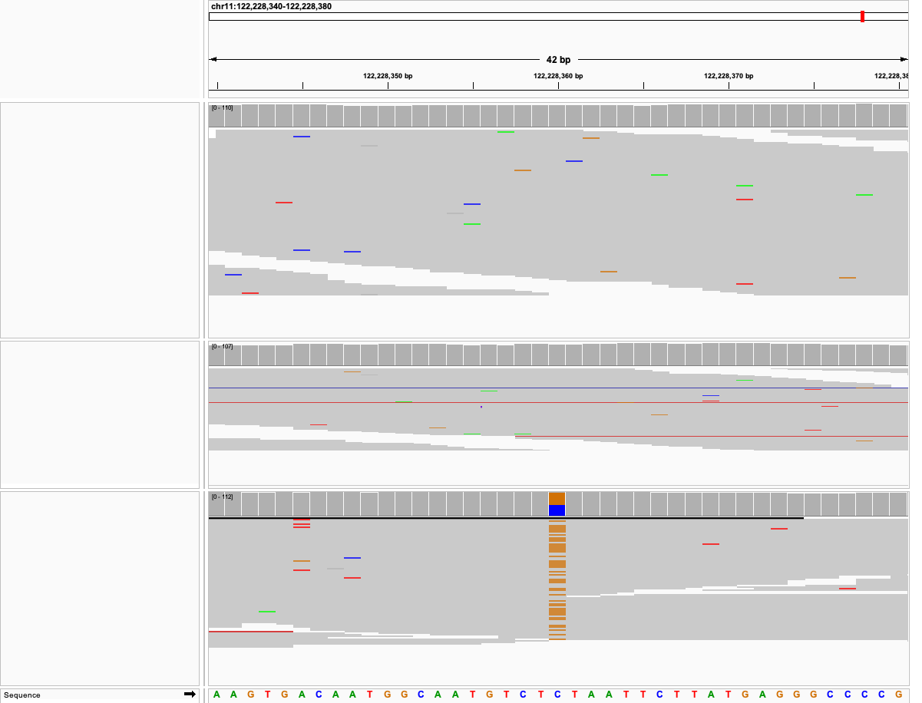
Dam
Sire
Offspring

Slide 52
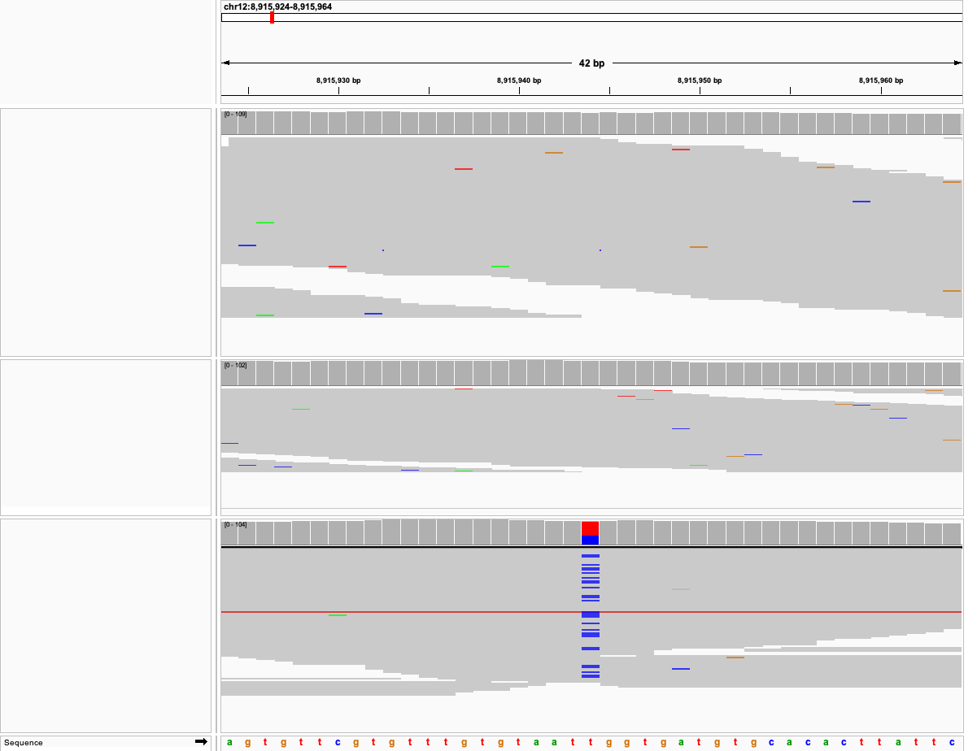
Dam
Sire
Offspring

Slide 53

Dam
Sire
Offspring

Slide 54

Dam
Sire
Offspring

Slide 55

Dam
Sire
Offspring

Slide 56

Dam
Sire
Offspring

Slide 57

Dam
Sire
Offspring

Slide 58

Dam
Sire
Offspring

Slide 59

Dam
Sire
Offspring

Slide 60

Dam
Sire
Offspring

Slide 61

Dam
Sire
Offspring

Slide 62

Dam
Sire
Offspring

Slide 63

Dam
Sire
Offspring

Slide 64

Dam
Sire
Offspring

Slide 65

Dam
Sire
Offspring

Slide 66

Dam
Sire
Offspring

Slide 67
Run 2

Slide 68

Sire
Dam
Offspring

Slide 69

Sire
Dam
Offspring

Slide 70

Sire
Dam
Offspring

Slide 71

Sire
Dam
Offspring

Slide 72

Sire
Dam
Offspring

Slide 73

Sire
Dam
Offspring

Slide 74

Sire
Dam
Offspring

Slide 75

Sire
Dam
Offspring

Slide 76

Sire
Dam
Offspring

Slide 77

Sire
Dam
Offspring

Slide 78

Sire
Dam
Offspring

Slide 79

Sire
Dam
Offspring

Slide 80

Sire
Dam
Offspring

Slide 81

Sire
Dam
Offspring

Slide 82

Sire
Dam
Offspring

Slide 83

Sire
Dam
Offspring

Slide 84

Sire
Dam
Offspring

Slide 85

Sire
Dam
Offspring

Slide 86

Sire
Dam
Offspring

Slide 87

Sire
Dam
Offspring

Slide 88

Sire
Dam
Offspring

Slide 89

Sire
Dam
Offspring

Slide 90

Sire
Dam
Offspring

Slide 91

Sire
Dam
Offspring

Slide 92

Sire
Dam
Offspring

Slide 93

Sire
Dam
Offspring

Slide 94

Sire
Dam
Offspring

Slide 95

Sire
Dam
Offspring

Slide 96

Sire
Dam
Offspring

Slide 97

Sire
Dam
Offspring

Slide 98

Sire
Dam
Offspring

Slide 99

Sire
Dam
Offspring

Slide 100

Sire
Dam
Offspring

Slide 101

Sire
Dam
Offspring

Slide 102

Sire
Dam
Offspring

Slide 103

Sire
Dam
Offspring

Slide 104

Sire
Dam
Offspring

Slide 105

Sire
Dam
Offspring

Slide 106

Sire
Dam
Offspring

Slide 107

Sire
Dam
Offspring

Slide 108

Sire
Dam
Offspring

Slide 109

Sire
Dam
Offspring

Slide 110

Sire
Dam
Offspring

Slide 111

Sire
Dam
Offspring

Slide 112

Sire
Dam
Offspring

Slide 113

Sire
Dam
Offspring

Slide 114

Sire
Dam
Offspring

Slide 115

Sire
Dam
Offspring

Slide 116

Sire
Dam
Offspring

Slide 117

Sire
Dam
Offspring

Slide 118

Sire
Dam
Offspring

Slide 119

Sire
Dam
Offspring

Slide 120

Sire
Dam
Offspring

Slide 121

Sire
Dam
Offspring

Slide 122

Sire
Dam
Offspring

Slide 123
Run 3

Slide 124

Sire
Dam
Offspring

Slide 125

Sire
Dam
Offspring

Slide 126

Sire
Dam
Offspring

Slide 127

Sire
Dam
Offspring

Slide 128

Sire
Dam
Offspring

Slide 129

Sire
Dam
Offspring

Slide 130

Sire
Dam
Offspring

Slide 131

Sire
Dam
Offspring

Slide 132

Sire
Dam
Offspring

Slide 133

Sire
Dam
Offspring

Slide 134

Sire
Dam
Offspring

Slide 135

Sire
Dam
Offspring

Slide 136

Sire
Dam
Offspring

Slide 137

Sire
Dam
Offspring

Slide 138

Sire
Dam
Offspring

Slide 139

Sire
Dam
Offspring

Slide 140

Sire
Dam
Offspring

Slide 141

Sire
Dam
Offspring

Slide 142

Sire
Dam
Offspring

Slide 143

Sire
Dam
Offspring

Slide 144

Sire
Dam
Offspring

Slide 145

Sire
Dam
Offspring

Slide 146

Sire
Dam
Offspring

Slide 147

Sire
Dam
Offspring

Slide 148

Sire
Dam
Offspring

Slide 149

Sire
Dam
Offspring

Slide 150

Sire
Dam
Offspring

Slide 151

Sire
Dam
Offspring

Slide 152

Sire
Dam
Offspring

Slide 153

Sire
Dam
Offspring

Slide 154

Sire
Dam
Offspring

Slide 155

Sire
Dam
Offspring

Slide 156

Sire
Dam
Offspring

Slide 157

Sire
Dam
Offspring

Slide 158

Sire
Dam
Offspring

Slide 159

Sire
Dam
Offspring

Slide 160

Sire
Dam
Offspring

Slide 161

Sire
Dam
Offspring

Slide 162

Sire
Dam
Offspring

Slide 163

Sire
Dam
Offspring

Slide 164

Sire
Dam
Offspring

Slide 165

Sire
Dam
Offspring

Slide 166

Sire
Dam
Offspring

Slide 167

Sire
Dam
Offspring

Slide 168

Sire
Dam
Offspring

Slide 169

Sire
Dam
Offspring

Slide 170

Sire
Dam
Offspring

Slide 171
Run 4

Slide 172

Sire
Dam
Offspring

Slide 173

Sire
Dam
Offspring

Slide 174

Sire
Dam
Offspring

Slide 175

Sire
Dam
Offspring

Slide 176

Sire
Dam
Offspring

Slide 177

Sire
Dam
Offspring

Slide 178

Sire
Dam
Offspring

Slide 179

Sire
Dam
Offspring

Slide 180

Sire
Dam
Offspring

Slide 181

Sire
Dam
Offspring

Slide 182

Sire
Dam
Offspring

Slide 183

Sire
Dam
Offspring

Slide 184

Sire
Dam
Offspring

Slide 185

Sire
Dam
Offspring

Slide 186

Sire
Dam
Offspring

Slide 187

Sire
Dam
Offspring

Slide 188

Sire
Dam
Offspring

Slide 189

Sire
Dam
Offspring

Slide 190

Sire
Dam
Offspring

Slide 191

Sire
Dam
Offspring

Slide 192

Sire
Dam
Offspring

Slide 193

Sire
Dam
Offspring

Slide 194

Sire
Dam
Offspring

Slide 195

Sire
Dam
Offspring

Slide 196

Sire
Dam
Offspring

Slide 197

Sire
Dam
Offspring

Slide 198

Sire
Dam
Offspring

Slide 199

Sire
Dam
Offspring

Slide 200

Sire
Dam
Offspring

Slide 201

Sire
Dam
Offspring

Slide 202

Sire
Dam
Offspring

Slide 203

Sire
Dam
Offspring

Slide 204

Sire
Dam
Offspring

Slide 205

Sire
Dam
Offspring

Slide 206

Sire
Dam
Offspring

Slide 207

Sire
Dam
Offspring

Slide 208

Sire
Dam
Offspring

Slide 209

Sire
Dam
Offspring

Slide 210

Sire
Dam
Offspring

Slide 211

Sire
Dam
Offspring

Slide 212

Sire
Dam
Offspring

Slide 213

Sire
Dam
Offspring

Slide 214

Sire
Dam
Offspring

Slide 215

Sire
Dam
Offspring

Slide 216

Sire
Dam
Offspring

Slide 217

Sire
Dam
Offspring

Slide 218

Sire
Dam
Offspring

Slide 219

Sire
Dam
Offspring

Slide 220

Sire
Dam
Offspring

Slide 221

Sire
Dam
Offspring

Slide 222

Sire
Dam
Offspring

Slide 223

Sire
Dam
Offspring

Slide 224

Sire
Dam
Offspring

Slide 225

Sire
Dam
Offspring

Slide 226

Sire
Dam
Offspring

Slide 227

Sire
Dam
Offspring

Slide 228
Run 5

Slide 229

Sire
Dam
Offspring

Slide 230

Sire
Dam
Offspring

Slide 231

Sire
Dam
Offspring

Slide 232

Sire
Dam
Offspring

Slide 233

Sire
Dam
Offspring

Slide 234

Sire
Dam
Offspring

Slide 235

Sire
Dam
Offspring

Slide 236

Sire
Dam
Offspring

Slide 237

Sire
Dam
Offspring

Slide 238

Sire
Dam
Offspring

Slide 239

Sire
Dam
Offspring

Slide 240

Sire
Dam
Offspring

Slide 241

Sire
Dam
Offspring

Slide 242

Sire
Dam
Offspring

Slide 243

Sire
Dam
Offspring

Slide 244

Sire
Dam
Offspring

Slide 245

Sire
Dam
Offspring

Slide 246

Sire
Dam
Offspring

Slide 247

Sire
Dam
Offspring

Slide 248

Sire
Dam
Offspring

Slide 249

Sire
Dam
Offspring

Slide 250

Sire
Dam
Offspring

Slide 251

Sire
Dam
Offspring

Slide 252

Sire
Dam
Offspring

Slide 253

Sire
Dam
Offspring

Slide 254

Sire
Dam
Offspring

Slide 255

Sire
Dam
Offspring

Slide 256

Sire
Dam
Offspring

Slide 257

Sire
Dam
Offspring

Slide 258

Sire
Dam
Offspring

Slide 259

Sire
Dam
Offspring

Slide 260

Sire
Dam
Offspring

Slide 261

Sire
Dam
Offspring

Slide 262

Sire
Dam
Offspring

Slide 263

Sire
Dam
Offspring

Slide 264

Sire
Dam
Offspring

Slide 265

Sire
Dam
Offspring

Slide 266

Sire
Dam
Offspring

Slide 267

Sire
Dam
Offspring

Slide 268

Sire
Dam
Offspring

Slide 269

Sire
Dam
Offspring

Slide 270

Sire
Dam
Offspring

Slide 271

Sire
Dam
Offspring

Slide 272

Sire
Dam
Offspring

Slide 273

Sire
Dam
Offspring

Slide 274

Sire
Dam
Offspring

Slide 275

Sire
Dam
Offspring

Slide 276

Sire
Dam
Offspring

Slide 277

Sire
Dam
Offspring

Slide 278

Sire
Dam
Offspring

Slide 279
Run 6

Slide 280

Sire
Dam
Offspring

Slide 281

Sire
Dam
Offspring

Slide 282

Sire
Dam
Offspring

Slide 283













Sire
Dam
Offspring

Slide 284

Sire
Dam
Offspring

Slide 285

Sire
Dam
Offspring

Slide 286

Sire
Dam
Offspring

Slide 287

Sire
Dam
Offspring

Slide 288

Sire
Dam
Offspring

Slide 289

Sire
Dam
Offspring

Slide 290

Sire
Dam
Offspring

Slide 291

Sire
Dam
Offspring

Slide 292

Sire
Dam
Offspring

Slide 293

Sire
Dam
Offspring

Slide 294

Sire
Dam
Offspring

Slide 295

Sire
Dam
Offspring

Slide 296

Sire
Dam
Offspring

Slide 297

Sire
Dam
Offspring

Slide 298

Sire
Dam
Offspring

Slide 299

Sire
Dam
Offspring

Slide 300

Sire
Dam
Offspring

Slide 301

Sire
Dam
Offspring

Slide 302

Sire
Dam
Offspring

Slide 303

Sire
Dam
Offspring

Slide 304

Sire
Dam
Offspring

Slide 305

Sire
Dam
Offspring

Slide 306

Sire
Dam
Offspring

Slide 307

Sire
Dam
Offspring

Slide 308

Sire
Dam
Offspring

Slide 309

Sire
Dam
Offspring

Slide 310

Sire
Dam
Offspring

Slide 311

Sire
Dam
Offspring

Slide 312

Sire
Dam
Offspring

Slide 313

Sire
Dam
Offspring

Slide 314

Sire
Dam
Offspring

Slide 315

Sire
Dam
Offspring

Slide 316

Sire
Dam
Offspring

Slide 317

Sire
Dam
Offspring

Slide 318
Run 7

Slide 319

Sire
Dam
Offspring

Slide 320

Sire
Dam
Offspring

Slide 321

Sire
Dam
Offspring

Slide 322

Sire
Dam
Offspring

Slide 323

Sire
Dam
Offspring

Slide 324

Sire
Dam
Offspring

Slide 325

Sire
Dam
Offspring

Slide 326

Sire
Dam
Offspring

Slide 327

Sire
Dam
Offspring

Slide 328

Sire
Dam
Offspring

Slide 329

Sire
Dam
Offspring

Slide 330

Sire
Dam
Offspring

Slide 331

Sire
Dam
Offspring

Slide 332

Sire
Dam
Offspring

Slide 333

Sire
Dam
Offspring

Slide 334

Sire
Dam
Offspring

Slide 335

Sire
Dam
Offspring

Slide 336

Sire
Dam
Offspring

Slide 337

Sire
Dam
Offspring

Slide 338

Sire
Dam
Offspring

Slide 339

Sire
Dam
Offspring

Slide 340

Sire
Dam
Offspring

Slide 341

Sire
Dam
Offspring

Slide 342

Sire
Dam
Offspring

Slide 343

Sire
Dam
Offspring

Slide 344

Sire
Dam
Offspring

Slide 345

Sire
Dam
Offspring

Slide 346

Sire
Dam
Offspring

Slide 347

Sire
Dam
Offspring

Slide 348

Sire
Dam
Offspring

Slide 349

Sire
Dam
Offspring

Slide 350

Sire
Dam
Offspring

Slide 351

Sire
Dam
Offspring

Slide 352

Sire
Dam
Offspring

Slide 353

Sire
Dam
Offspring

Slide 354

Sire
Dam
Offspring

Slide 355

Sire
Dam
Offspring

Slide 356

Sire
Dam
Offspring

Slide 357

Sire
Dam
Offspring

Slide 358

Sire
Dam
Offspring

Slide 359

Sire
Dam
Offspring

Slide 360

Sire
Dam
Offspring

Slide 361

Sire
Dam
Offspring

Slide 362

Sire
Dam
Offspring

Slide 363

Sire
Dam
Offspring

Slide 364

Sire
Sire
Dam
Dam
Offspring
Offspring

Slide 365

Sire
Dam
Offspring

Slide 366

Sire
Dam
Offspring

Slide 367
Run 8

Slide 368

Sire
Dam
Offspring

Slide 369

Sire
Dam
Offspring

Slide 370

Sire
Dam
Offspring

Slide 371

Sire
Dam
Offspring

Slide 372

Sire
Dam
Offspring

Slide 373

Sire
Dam
Offspring

Slide 374

Sire
Dam
Offspring

Slide 375

Sire
Dam
Offspring

Slide 376

Sire
Dam
Offspring

Slide 377

Sire
Dam
Offspring

Slide 378

Sire
Dam
Offspring

Slide 379

Sire
Dam
Offspring

Slide 380

Sire
Dam
Offspring

Slide 381

Sire
Dam
Offspring

Slide 382

Sire
Dam
Offspring

Slide 383

Sire
Dam
Offspring

Slide 384

Sire
Dam
Offspring

Slide 385

Sire
Dam
Offspring

Slide 386

Sire
Dam
Offspring

Slide 387

Sire
Dam
Offspring

Slide 388

Sire
Dam
Offspring

Slide 389

Sire
Dam
Offspring

Slide 390

Sire
Dam
Offspring

Slide 391

Sire
Dam
Offspring

Slide 392

Sire
Dam
Offspring

Slide 393

Sire
Dam
Offspring

Slide 394

Sire
Dam
Offspring

Slide 395

Sire
Dam
Offspring

Slide 396

Sire
Dam
Offspring

Slide 397

Sire
Dam
Offspring

Slide 398

Sire
Dam
Offspring

Slide 399

Sire
Dam
Offspring

Slide 400

Sire
Dam
Offspring

Slide 401

Sire
Dam
Offspring

Slide 402

Sire
Dam
Offspring

Slide 403
Run 9

Slide 404

Sire
Dam
Offspring

Slide 405

Sire
Dam
Offspring

Slide 406

Sire
Dam
Offspring

Slide 407

Sire
Dam
Offspring

Slide 408

Sire
Dam
Offspring

Slide 409

Sire
Dam
Offspring

Slide 410

Sire
Dam
Offspring

Slide 411

Sire
Dam
Offspring

Slide 412

Sire
Dam
Offspring

Slide 413

Sire
Dam
Offspring

Slide 414

Sire
Dam
Offspring

Slide 415

Sire
Dam
Offspring

Slide 416

Sire
Dam
Offspring

Slide 417

Sire
Dam
Offspring

Slide 418

Sire
Dam
Offspring

Slide 419

Sire
Dam
Offspring

Slide 420

Sire
Dam
Offspring

Slide 421

Sire
Dam
Offspring

Slide 422

Sire
Dam
Offspring

Slide 423

Sire
Dam
Offspring

Slide 424

Sire
Dam
Offspring

Slide 425

Sire
Dam
Offspring

Slide 426

Sire
Dam
Offspring

Slide 427

Sire
Dam
Offspring

Slide 428

Sire
Dam
Offspring

Slide 429

Sire
Dam
Offspring

Slide 430

Sire
Dam
Offspring

Slide 431

Sire
Dam
Offspring

Slide 432

Sire
Dam
Offspring

Slide 433

Sire
Dam
Offspring

Slide 434

Sire
Dam
Offspring

Slide 435

Sire
Dam
Offspring

Slide 436

Sire
Dam
Offspring

Slide 437

Sire
Dam
Offspring

Slide 438

Sire
Dam
Offspring

Slide 439

Sire
Dam
Offspring

Slide 440

Sire
Dam
Offspring

Slide 441

Sire
Dam
Offspring

Slide 442

Sire
Dam
Offspring

Slide 443

Sire
Dam
Offspring

Slide 444

Sire
Dam
Offspring

Slide 445

Sire
Dam
Offspring

Slide 446

Sire
Dam
Offspring

Slide 447

Sire
Dam
Offspring

Slide 448

Sire
Dam
Offspring

Slide 449

Sire
Dam
Offspring

Slide 450

Sire
Dam
Offspring

Slide 451

Sire
Dam
Offspring

Slide 452

Sire
Dam
Offspring

Slide 453

Sire
Dam
Offspring

Slide 454

Sire
Dam
Offspring

Slide 455

Sire
Dam
Offspring

Slide 456

Sire
Dam
Offspring

Slide 457

Sire
Dam
Offspring

Slide 458

Sire
Dam
Offspring

Slide 459
Run 10

Slide 460

Sire
Dam
Offspring

Slide 461

Sire
Dam
Offspring

Slide 462

Sire
Dam
Offspring

Slide 463

Sire
Dam
Offspring

Slide 464

Sire
Dam
Offspring

Slide 465

Sire
Dam
Offspring

Slide 466

Sire
Dam
Offspring

Slide 467

Sire
Dam
Offspring

Slide 468

Sire
Dam
Offspring

Slide 469

Sire
Dam
Offspring

Slide 470

Sire
Dam
Offspring

Slide 471

Sire
Dam
Offspring

Slide 472

Sire
Dam
Offspring

Slide 473

Sire
Dam
Offspring

Slide 474

Sire
Dam
Offspring

Slide 475

Sire
Dam
Offspring

Slide 476

Sire
Dam
Offspring

Slide 477

Sire
Dam
Offspring

Slide 478

Sire
Dam
Offspring

Slide 479

Sire
Dam
Offspring

Slide 480

Sire
Dam
Offspring

Slide 481

Sire
Dam
Offspring

Slide 482

Sire
Dam
Offspring

Slide 483

Sire
Dam
Offspring

Slide 484

Sire
Dam
Offspring

Slide 485

Sire
Dam
Offspring

Slide 486

Sire
Dam
Offspring

Slide 487

Sire
Dam
Offspring

Slide 488

Sire
Dam
Offspring

Slide 489

Sire
Dam
Offspring

Slide 490

Sire
Dam
Offspring

Slide 491

Sire
Dam
Offspring

Slide 492

Sire
Dam
Offspring

Slide 493

Sire
Dam
Offspring

Slide 494

Sire
Dam
Offspring

Slide 495

Sire
Dam
Offspring

Slide 496

Sire
Dam
Offspring

Slide 497

Sire
Dam
Offspring

Slide 498

Sire
Dam
Offspring

Slide 499

Sire
Dam
Offspring

Slide 500

Sire
Dam
Offspring

Slide 501

Sire
Dam
Offspring

Slide 502

Sire
Dam
Offspring

Slide 503

Sire
Dam
Offspring

Slide 504

Sire
Dam
Offspring

Slide 505

Sire
Dam
Offspring

Slide 506

Sire
Dam
Offspring

Slide 507

Sire
Dam
Offspring

Slide 508

Sire
Dam
Offspring

Slide 509

Sire
Dam
Offspring

Slide 510

Sire
Dam
Offspring

Slide 511

Sire
Dam
Offspring

Slide 512

Sire
Dam
Offspring

Slide 513

Sire
Dam
Offspring

Slide 514

Sire
Dam
Offspring

Slide 515

Sire
Dam
Offspring

Slide 516

Sire
Dam
Offspring

Slide 517

Sire
Dam
Offspring

Slide 518

Sire
Dam
Offspring

Slide 519

Sire
Dam
Offspring

Slide 520

Sire
Dam
Offspring

Slide 521

Sire
Dam
Offspring

Slide 522

Sire
Dam
Offspring

Slide 523
FPs

Slide 524
Run 2

Slide 525

Sire
Dam
Offspring

Slide 526

Sire
Dam
Offspring

Slide 527

Sire
Dam
Offspring

Slide 528
Run 3

Slide 529

Sire
Dam
Offspring

Slide 530

Sire
Dam
Offspring

Slide 531

Sire
Dam
Offspring

Slide 532

Sire
Dam
Offspring

Slide 533
Run 4

Slide 534

Sire
Dam
Offspring

Slide 535

Sire
Dam
Offspring

Slide 536

Sire
Dam
Offspring

Slide 537

Sire
Dam
Offspring

Slide 538
Run 5

Slide 539

Sire
Dam
Offspring

Slide 540

Sire
Dam
Offspring

Slide 541
Run 6

Slide 542

Sire
Dam
Offspring

Slide 543

Sire
Dam
Offspring

Slide 544

Sire
Dam
Offspring

Slide 545

Sire
Dam
Offspring

Slide 546

Sire
Dam
Offspring

Slide 547

Sire
Dam
Offspring

Slide 548
Run 7

Slide 549

Sire
Dam
Offspring

Slide 550

Sire
Dam
Offspring

Slide 551

Sire
Dam
Offspring

Slide 552

Sire
Dam
Offspring

Slide 553
Run 8

Slide 554

Sire
Dam
Offspring

Slide 555

Sire
Dam
Offspring

Slide 556

Sire
Dam
Offspring

Slide 557

Sire
Dam
Offspring

Slide 558
Run 9

Slide 559

Sire
Dam
Offspring

Slide 560

Sire
Dam
Offspring

Slide 561

Sire
Dam
Offspring

Slide 562

Sire
Dam
Offspring

Slide 563
Run 10

Slide 564

Sire
Dam
Offspring

Slide 565

Sire
Dam
Offspring

Slide 566

Sire
Dam
Offspring

Slide 567

Sire
Dam
Offspring

Slide 568

Sire
Dam
Offspring

Slide 569

Sire
Dam
Offspring

Slide 570

Sire
Dam
Offspring

Slide 571

Sire
Dam
Offspring

